Slide 1
Systems Analysis and Design 3. System Analysis
Romi Satria Wahono romi@romisatriawahono.net http://romisatriawahono.net/sad WA/Telegram: +6281586220090

Slide 2
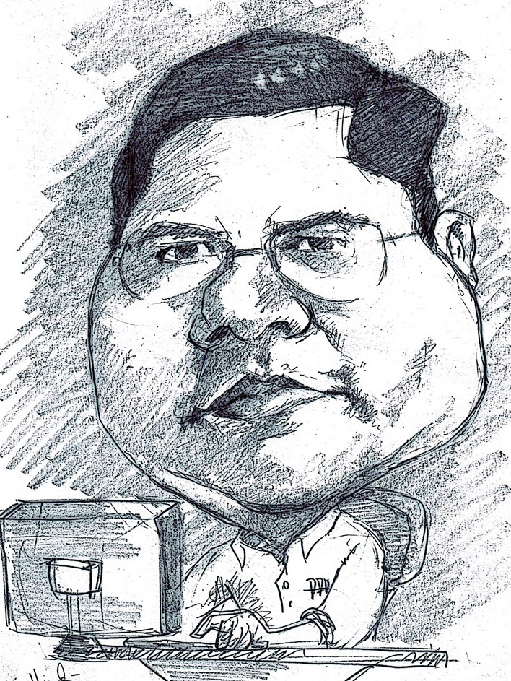
Romi Satria Wahono
SMA Taruna Nusantara Magelang (1993)
B.Eng, M.Eng and Ph.D in Software Engineering Saitama University Japan (1994-2004) Universiti Teknikal Malaysia Melaka (2014)
Research Interests in Software Engineering and Machine Learning
LIPI Researcher (2004-2007)
Founder and CEO:
PT IlmuKomputerCom Braindevs Sistema
PT Brainmatics Cipta Informatika
Professional Member of IEEE, ACM and PMI
IT Award Winners from WSIS (United Nations), Kemdikbud, LIPI, etc
Industrial IT Certifications: TOGAF, ITIL, CCNA, etc
Enterprise Architecture Consultant: KPK, UNSRI, LIPI, Ristek Dikti, DJPK Kemenkeu, Kemsos, INSW, etc

Slide 3
Course Outline
1. Introduction
2. Project Planning
3. System Analysis
4. System Design
5. System Implementation

Slide 4
3. System Analysis
3.1 Requirement Gathering
3.2 Business Process Analysis
3.3 Analysis and Design

Slide 5
Recap
Business Value Identification (System Request)
Lower Cost
Increase Profit
Feasibility Analysis
Technical (Capabilities)
Organizational (Goals, Core Business)
Economic (ROI, BEP)

Slide 6
SDLC and Deliverables
Implementation (New System)
Design (System Specification)
Analysis (System Specification)
Planning
(System Proposal)

Slide 7
3.1 Requirement Gathering

Slide 8
Boehm’s First Law
Errors are most frequent during the requirements and design activities, and are the more expensive the later they are removed
(Endres, 2003)
Notes:
Kesalahan paling sering terjadi selama persyaratan dan aktivitas desain, dan lebih mahal adalah semakin mahal nantinya mereka dihapus

Slide 9
What is a Requirement
Business Requirement
Statement of what the system must do
Focus on what the system must do, not how to do it
There are 2 kinds of requirements
Functional Requirement
Nonfunctional Requirement
Notes:
Kebutuhan Bisnis
Pernyataan tentang apa yang harus dilakukan sistem
Fokus pada apa yang harus dilakukan sistem, bukan bagaimana melakukannya

Slide 10
1. Functional Requirement
Defines the functions of the system must carry out
Specifies the process that must be performed, examples:
Diagrams:
Use Case Diagrams
Activity Diagrams
Problem Statements:
Must search for inventory
Must perform these calculations
Must produce a specific report

Slide 11
2. Nonfunctional Requirements
Operational – Physical/technical environment
Performance – Speed and reliability
Security – Who can use the system
Cultural & Political – Company policies, legal issues

Slide 12
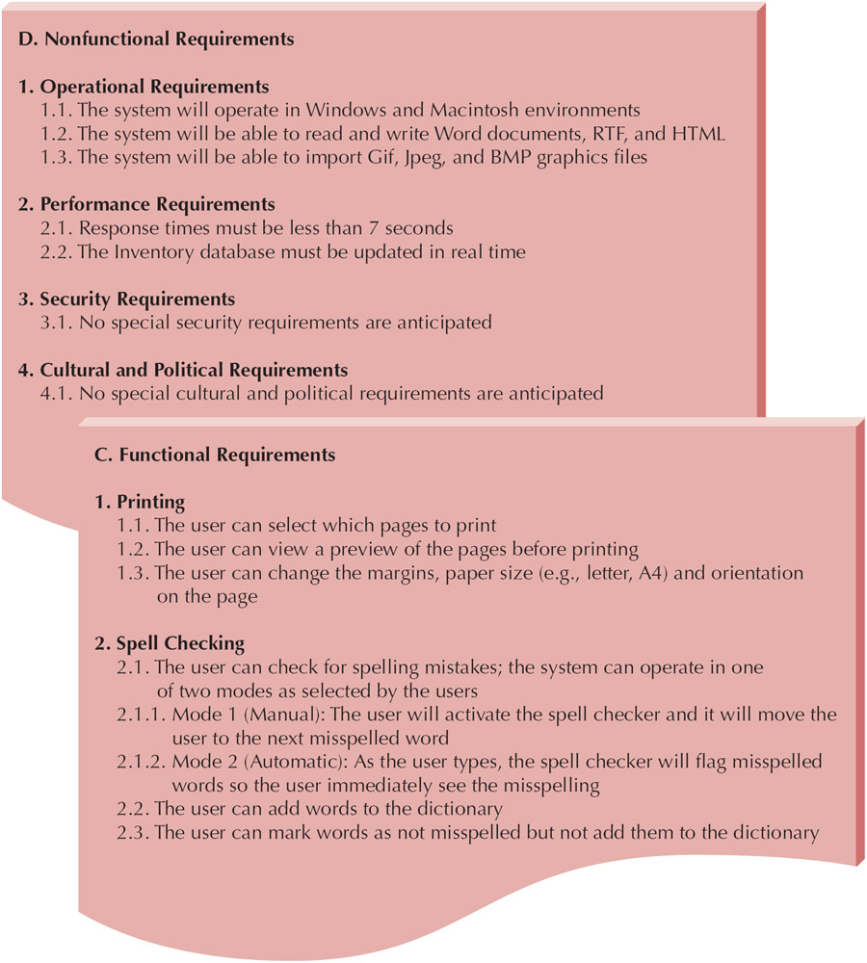

Slide 13
Requirement Gathering Methods
Document Analysis
Interviews
Joint Application Design (JAD)
Questionnaires
Observation

Slide 14
1. Document Analysis
Provides clues about the "formal" existing As-Is system
Typical documents
Forms
Reports
Policy manuals
Look for user additions to forms
Look for unused form elements
Do document analysis before interviews
Notes:
Memberikan petunjuk tentang kondisi “bentuk" sistem sekarang
Cari tambahan pengguna ke formulir
Cari elemen formulir yang tidak digunakan
Lakukan analisis dokumen sebelum wawancara

Slide 15
2. Interviews
Most commonly used technique
Very natural
If you need to know something, you ask someone
Five basic steps:
Selecting interviewees
Designing interview questions
Preparing for the interview
Conducting the interview
Post-interview follow-up

Slide 16
3. Joint Application Design (JAD)
Allows project managers, users, and developers to work together
May reduce scope creep by 50%
Avoids requirements being too specific or too vague
Include 10 to 20 users
Tend to last 5 to 10 days over a three week period
Notes:
Menghindari persyaratan yang terlalu spesifik atau terlalu kabur
Sertakan 10 hingga 20 User
Cenderung bertahan 5 hingga 10 hari selama tiga minggu

Slide 17
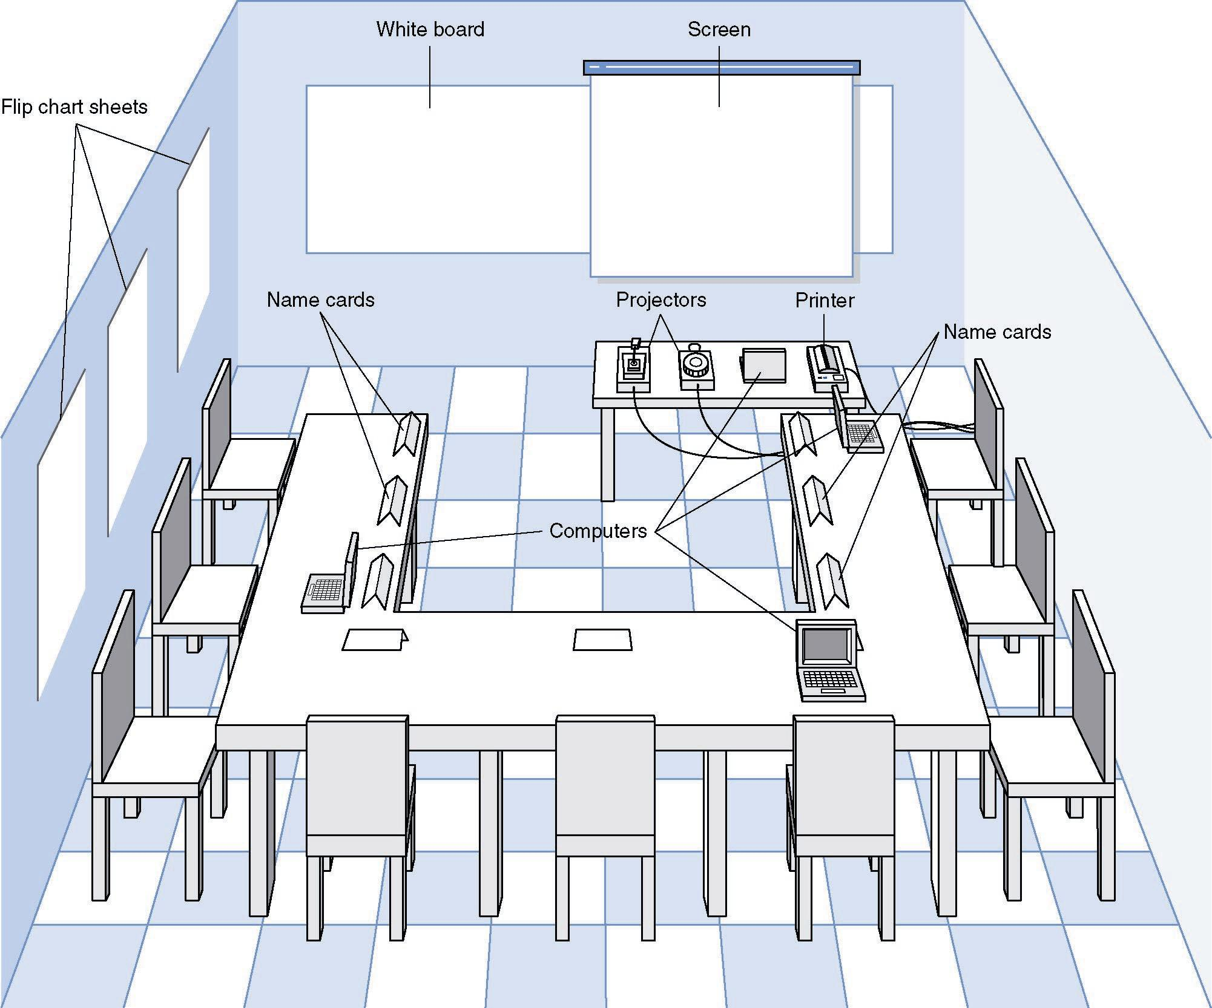
JAD Meeting Room
JPEG Figure 5-5 Goes Here

Slide 18
4. Questionnaire
Selecting participants
Using samples of the population
Designing the questionnaire
More important than interview questions
Prioritize questions to grab attention
Distinguish between:
Fact-oriented questions (specific answers)
Opinion questions (agree – disagree scale)
Administering the questionnaire
Explain its importance & how it will be used
Give expected response date
Follow up on late returns
Have supervisors follow up
Promise to report results
Questionnaire follow-up
Send results to participants
Notes:
Membedakan antara:
Jelaskan pentingnya & bagaimana itu akan digunakan
Berikan tanggal respons yang diharapkan
Menindaklanjuti pengembalian terlambat
Mintalah pengawas untuk menindaklanjuti
Berjanji untuk melaporkan hasil

Slide 19
5. Observation
Users/managers often don’t remember everything they do
Validates info gathered in other ways
Behaviors change when people are watched
Keep low profile, don’t change the process
Careful not to ignore periodic activities
Weekly … Monthly … Annual
Notes:
Pengguna / manajer sering kali tidak mengingat semua yang mereka lakukan
Memvalidasi info yang dikumpulkan dengan cara lain
Perilaku berubah ketika orang diawasi
Tetap low profile, jangan ubah prosesnya
Hati-hati jangan sampai mengabaikan aktivitas periodik

Slide 20
Selecting the Appropriate Techniques
Interviews JAD Questionnaires Document Observation
Analysis
Type of As-Is As-Is As-Is As-Is As-Is
Information Improve. Improve. Improve.
To-Be To-Be
Depth of High High Medium Low Low
Information
Breadth of Low Medium High High Low
Information
Integration Low High Low Low Low
of Info.
User Medium High Low Low Low
Involvement
Cost Medium Low- Low Low Low-
Medium Medium
Notes:
Depth of Information = Kedalaman Informasi
Breadth of Information = Luasnya Informasi
Integrasi Informasi
Keterlibatan User

Slide 21
3.2 Business Process Analysis

Slide 22
Business Process Analysis Strategies
BPA (Business Process Automation)
Makes almost no changes to business processes, just makes them more efficient
BPI (Business Process Improvement)
Change what the users do, not just how efficiently they do it
BPR (Business Process Reengineering)
Throw away everything, start with a blank page
Notes:
Hampir tidak ada perubahan pada proses bisnis, hanya membuatnya lebih efisien
Ubah apa yang dilakukan pengguna, bukan hanya seberapa efisien mereka melakukannya
Buang semuanya, mulailah dengan halaman kosong

Slide 23
Strategy Comparation
Business Business Business
Process Process Process
Automation Improvement Reeingineering
Potential Business Low-Moderate Moderate High
Value
Project Cost Low Low-Moderate High
Breadth of
Analysis Narrow Narrow-Moderate Very Broad
Risk Low Low-Moderate Very High

Slide 24
Barriers to Requirements Elicitation
The "Yes, But" Syndrome
The "Undiscovered Ruins" Syndrome
The "User and the Developer" Syndrome
Notes:
2. Sindrom Reruntuhan Yang Belum Ditemukan

Slide 25
The "Yes, But" Syndrome
Untuk alasan apa pun, kami selalu melihat dua reaksi langsung, berbeda, dan terpisah ketika pengguna melihat implementasi sistem untuk pertama kalinya.
"Wow, this is so cool; we can really use this, what a neat job" and so on.
"Yes, but, hmmmmm, now that I see it, what about this ... ? Wouldn't it be nice if . . . ? Whatever happened to . . . ?“

Slide 26
The "Undiscovered Ruins" Syndrome
Dalam banyak hal, pencarian persyaratan seperti pencarian reruntuhan yang belum ditemukan
Semakin banyak Anda temukan, semakin banyak yang Anda tahu tetap ada
Anda tidak pernah benar-benar merasa bahwa Anda telah menemukan semuanya, dan mungkin Anda tidak akan pernah menemukannya.
Memang, tim pengembangan perangkat lunak selalu berjuang untuk menentukan kapan mereka selesai dengan persyaratan elisitasi. Kapan mereka ditemukan
all the requirements
atau persyaratan yang cukup?

Slide 27
The "User and the Developer" Syndrome
Communication gap between the user and the developer
Users and developers are typically from different worlds, may even speak different languages, and have different backgrounds, motivations, and objectives

Slide 28
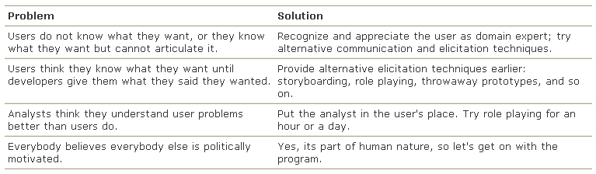
The "User and the Developer" Syndrome
Reasons for this problem and some suggested solutions

Slide 29
Key Points
Requirements elicitation is complicated by three endemic syndromes
The "Yes, But" syndrome stems from human nature and the users' inability to experience the software as they might a physical device
Searching for requirements is like searching for "Undiscovered Ruins"; the more you find, the more you know remain
The "User and the Developer" syndrome reflects the profound differences between these two, making communication difficult

Slide 30
3.3 Analysis and Design

Slide 31
Analysis Design Paradigm and Diagrams
 | Paradigm | Diagrams
1 | Process-oriented | Flowchart
2 | Data-oriented | DFD
3 | Object-oriented (data + process) | UML

Slide 32
3.3.1 Unified Modeling Language (UML)

Slide 33
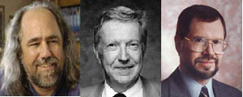
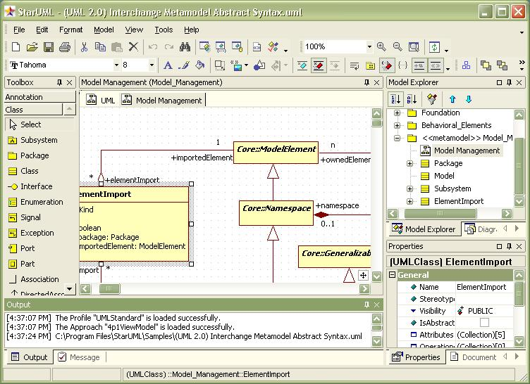
Sejarah UML
Booch, Jacobson, Rumbaugh
In the 90s, many people creating OO diagramming languages
Three different ones created by Grady Booch, Ivar Jacobson, James Rumbaugh
Joined forces with
Rational (company) to
create Unified Modeling
Langauge (UML)

Slide 34
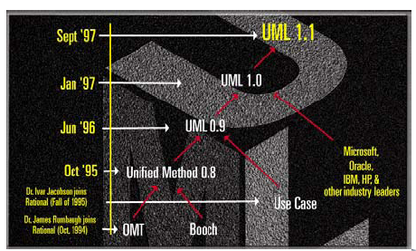
Sejarah UML
2003 → UML 2.0
2011 → UML 2.4

Slide 35
What is the UML?
UML: Unified Modeling Language
UML can be used for modeling all processes in the development life cycle and across different implementation technologies (technology and language independent)
UML is the standard language for visualizing, specifying, constructing, and documenting the artifacts of a software-intensive system
UML is a communication tool – for the team, and other stakeholders

Slide 36
The Triangle of Success in Software Dev.
Notation: Standard
Tools: Support Standard and Process
Process: Customer-Oriented Methodology

Slide 37
UML Tools
Rational Rose
Visual Paradigm
Enterprise Architect
Microsoft Visio
Star UML
Netbeans UML Plugin

Slide 38
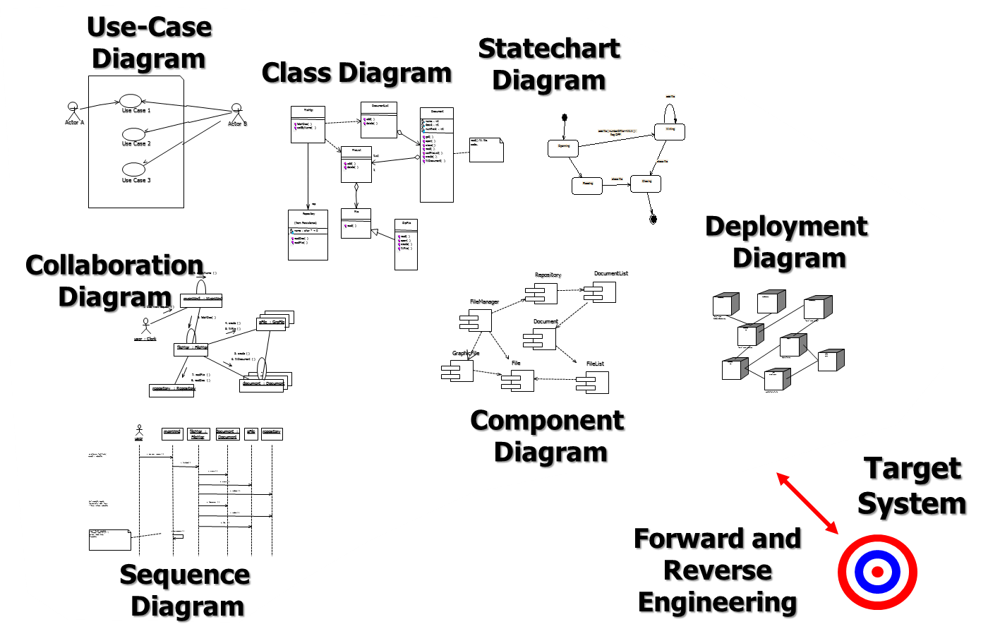
UML 2.0 Diagrams
UML version 2.0 has 14 diagrams in 2 groups:
Structure Diagrams
Behavior Diagrams

Slide 39
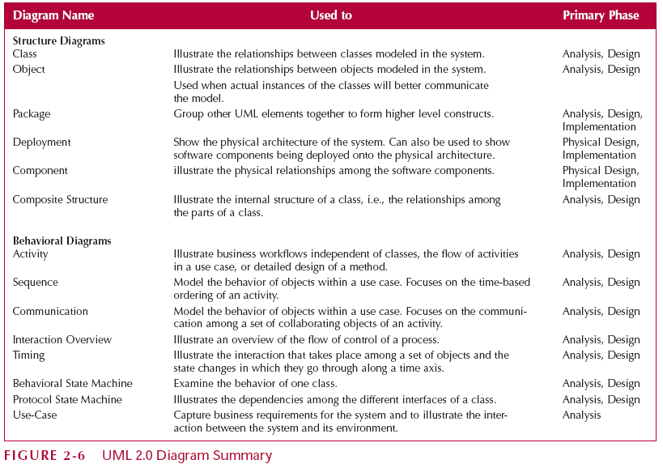
UML 2.0 Diagram

Slide 40
UML Structure Diagrams
Represent the data and static relationships in an information system
Class Diagram
Object Diagram
Package Diagram
Deployment Diagram
Component Diagram
Composite Structure Diagram

Slide 41
Structure Diagrams
Class Diagrams
Common vocabulary used by analyst and users
Represent things (employee, paycheck,…)
Shows the relationships between classes
Object Diagrams
Similar to class diagrams
Instantiation of a class diagram
Relationships between objects
Package Diagrams
Group UML elements together to form higher level constructs

Slide 42
Structure Diagrams
Deployment Diagrams
Shows the physical architecture and software components of system
For example, network nodes
Component Diagrams
Physical relationships among software components
Example – Client/Server (Which machines run which software)
Composite Structure
Illustrates internal structure of a complex class

Slide 43
UML Behavior Diagrams
Depict the dynamic relationships among the instances or objects that represent the business information system
Activity Diagram
Sequence Diagram
Communication Diagram
Interaction Diagram
Timing Diagram
Behavior State Machine
Protocol State Machine
Use Case Diagrams

Slide 44
Behavior Diagrams
Activity Diagrams
Model processes in an information system
Example: Business workflows, business logic
Interaction Diagrams
Shows interaction among objects
Sequence Diagrams
Time-based ordering of the interaction
Communication Diagrams
Communication among a set of collaborating objects of an activity

Slide 45
Behavior Diagrams
Interaction Diagrams
Overview of flow of control of a process
Timing Diagrams
Show how an object changes over time
State Machines
Examines behavior of one class
Models the different states and state transitions an object can experience
Use-Case Diagrams
Shows interaction between the system and environment
Captures business requirements

Slide 46
UML Problems
UML is modeling notation, it is not a development process or a methodology
UML driven development process?
UML is too complex, difficult to understand quickly
Should we use all UML diagrams?

Slide 47
UML Process (EA Sparx)
Display the boundary of a system and its major functions using use cases and actors
Model the organization’s business process with activity diagram
Illustrate use case realizations with sequence diagrams
Represent a static structure of a system using class diagrams
Reveal the physical implementation architecture with deployment diagrams

Slide 48
UML Process (EA Sparx)
Use Cases Diagram
Activity Diagram
Sequence Diagram
Class Diagram
Deployment Diagrams

Slide 49
UML Process (Kendal, 2011)
A use case diagram, describing how the system is used. Analysts start with a use case diagram
An activity diagram, illustrating the overall flow of activities. Each use case may create one activity diagram
Sequence diagrams, showing the sequence of activities and class relationships. Each use case may create one or more sequence diagrams
Class diagrams, showing the classes and relationships. Sequence diagrams are used to determine classes
Statechart diagrams, showing the state transitions. Each class may create a statechart diagram, which is useful for determining class methods

Slide 50
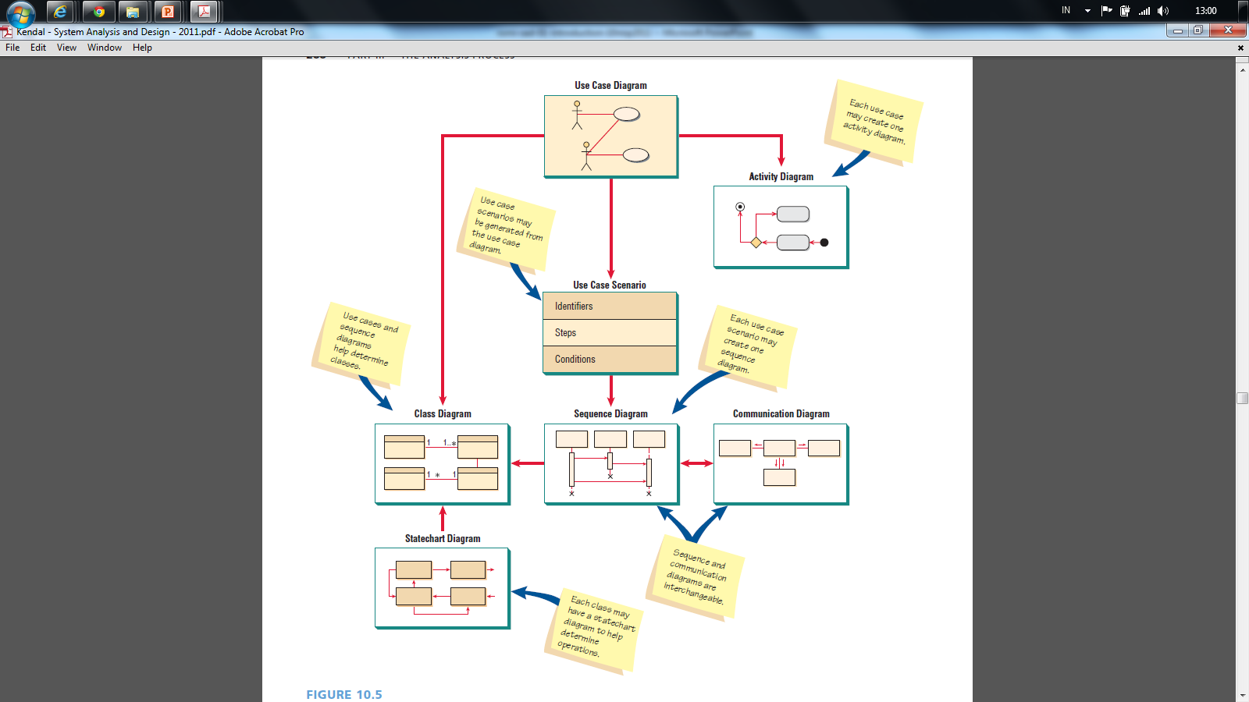
(Kendall and Kendall, 2011)

Slide 51
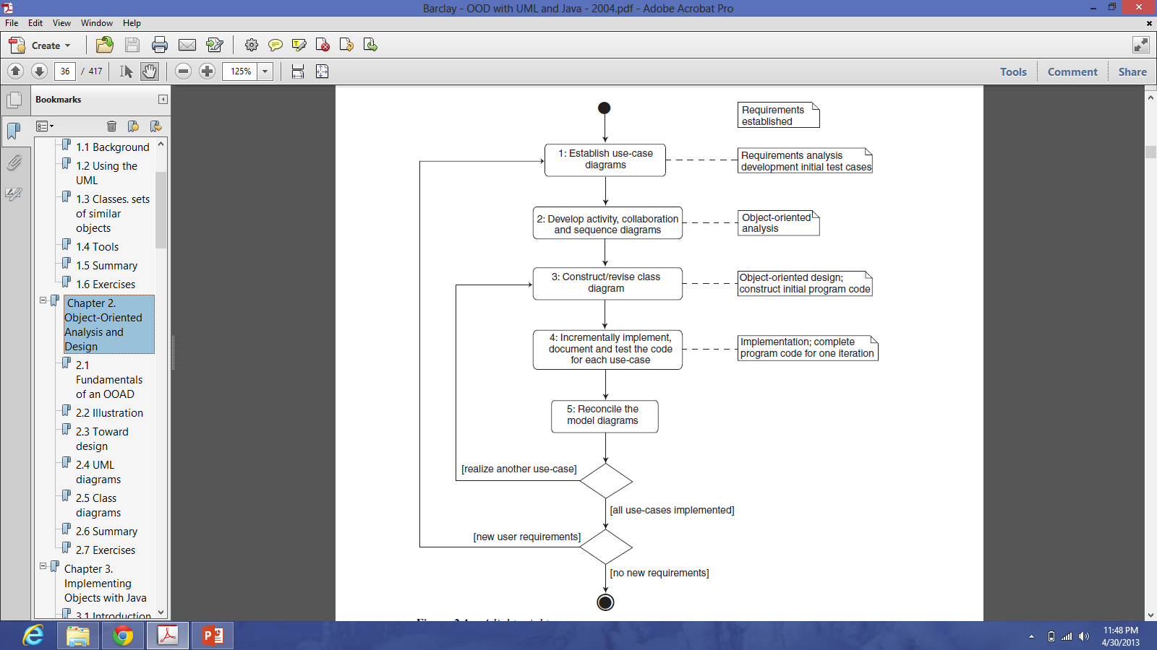
UML Process (Barclay, 2004)

Slide 52
System Analysis and Design with UML
System Analysis
Business Process Identification
Use Case Diagram
Business Process Modeling
Activity Diagram or Business Process Modeling Notation (BPMN)
Business Process Realization
Sequence Diagram (Buat untuk setiap use case dengan menggunakan pola Boundary-Control-Entity)
System Design
Program Design
Class Diagram (Gabungkan Boundary-Control-Entity Class dan susun story dari sistem yang dibangun)
Package Diagram (Gabungan class yang sesuai, boleh menggunakan pola B-C-E)
Deployment Diagram (arsitektur software dari sistem yang dibangun)
User Interface Design (Buat UI design dari Boundary Class)
Entity-Relationship Model (Buat ER diagram dari Entity Class)

Slide 53
SDLC and Deliverables
Planning
1.1 System Request
1.2 Feasibility Analysis
Analysis
2.1 Use Case Diagram
2.2 Activity Diagram
2.3 Sequence Diagram
Design
3.1 Class Diagram
3.2 Deployment Diagram
3.3 User Interface Design
3.4 Data Model
Implementation 4.1 Program Code 4.2 Testing Plan 4.3 Documentation
System
Proposal
System
Specification
New
Software

Slide 54
3.3.2 Case Study: ATM System

Slide 55
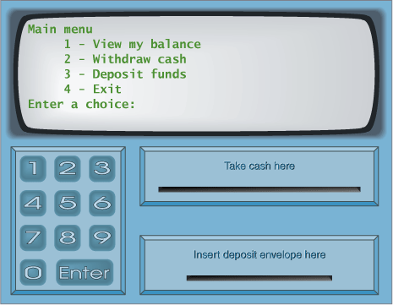
ATM System

Slide 56
ATM System
Layar
Kotak Uang
Kotak Kartu
Kotak Kuitansi

Slide 57
Menu PIN
Masukkan PIN:
Kotak Uang
Kotak Kartu
Kotak Kuitansi

Slide 58
Menu Utama
Mengecek Saldo
Mentransfer Uang
Mengambil Uang
Logout
Kotak Uang
Kotak Kartu
Kotak Kuitansi

Slide 59
Menu Pengecekan Saldo
Saldo anda adalah …
Kotak Uang
Kotak Kartu
Kotak Kuitansi

Slide 60
Menu Pengiriman Uang
No Account Penerima:
Kotak Uang
Kotak Kartu
Kotak Kuitansi

Slide 61
Menu Pengiriman Uang
Jumlah uang yang dikirim:
Kotak Uang
Kotak Kartu
Kotak Kuitansi

Slide 62
Menu Pengiriman Uang
Uang berhasil terkirim
Kotak Uang
Kotak Kartu
Kotak Kuitansi

Slide 63
Menu Pengambilan Uang
Jumlah uang yang diambil:
Kotak Uang
Kotak Kartu
Kotak Kuitansi

Slide 64
Menu Pengambilan Uang
Uang berhasil diambil
Kotak Uang
Kotak Kartu
Kotak Kuitansi

Slide 65
System Analysis and Design with UML
System Analysis
Business Process Identification
Use Case Diagram
Business Process Modeling
Activity Diagram or Business Process Modeling Notation (BPMN)
Business Process Realization
Sequence Diagram (Buat untuk setiap use case dengan menggunakan pola Boundary-Control-Entity)
System Design
Program Design
Class Diagram (Gabungkan Boundary-Control-Entity Class dan susun story dari sistem yang dibangun)
Package Diagram (Gabungan class yang sesuai, boleh menggunakan pola B-C-E)
Deployment Diagram (arsitektur software dari sistem yang dibangun)
User Interface Design (Buat UI design dari Boundary Class)
Entity-Relationship Model (Buat ER diagram dari Entity Class)

Slide 66
3.3.3 Business Process Identification
Use Case Diagram

Slide 67
Use Case Diagrams
Summarized into a single picture
All of the use cases for the part of the system being modeled
Use case represents the discrete activities performed by the user
Use Case Diagram tells what the system will do
Good for communicating with users

Slide 68
Use Case Diagram Syntax
Actor
person or system that derives benefit from and is external to the subject
Use Case
Represents a major piece of system functionality
Association Relationship
Include Relationship
Extend Relationship
Generalization Relationship
<<includes>>
<<extends>>

Slide 69
Use Case
A major piece of system functionality
Can extend other Use Cases
Placed inside system boundary
Labeled with descriptive verb - noun phrase
Use Case

Slide 70
System Boundary
Includes the name of the system inside or on top
Represents the scope of the system
Actors are outside the scope of the system
Boundary

Slide 71
Actor
A person or another system that interacts with the current system
A role, not a specific user
Provides input, receives output, or both
⟨⟨actor⟩⟩
Actor/Role

Slide 72
Association Relationship
Links actor and the Use Case
Shows two-way communication
If one-way, arrows are used
* is for "multiplicity of the Association"
*
*

Slide 73
Extends Relationship
Extends Use Case to include Optional behavior
Arrow points from the extension Use Case to the base Use Case
⟨⟨extend⟩⟩
Make Payment
Arrangement
⟨⟨extend⟩⟩
Make Appointment

Slide 74
Include Relationship
Include one Use Case from within another
Arrow points from base Use Case to the included Use Case
⟨⟨include⟩⟩
Make New
Patient Appointment
⟨⟨include⟩⟩
Create New Patient

Slide 75
Generalization Relationship
A specialized Use Case to a more generalized Use Case
Arrow points from specialized to general Use Case
Make Old Appointment
Make Appointment

Slide 76
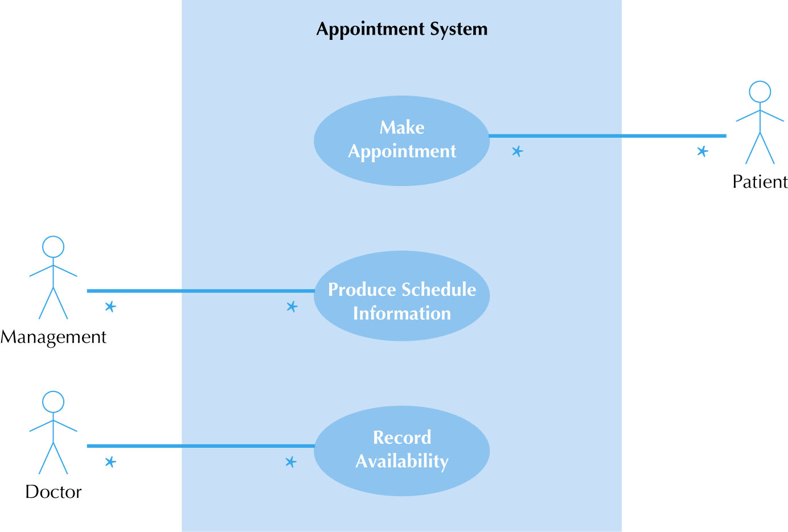
Use Case Diagram for Appointment System

Slide 77
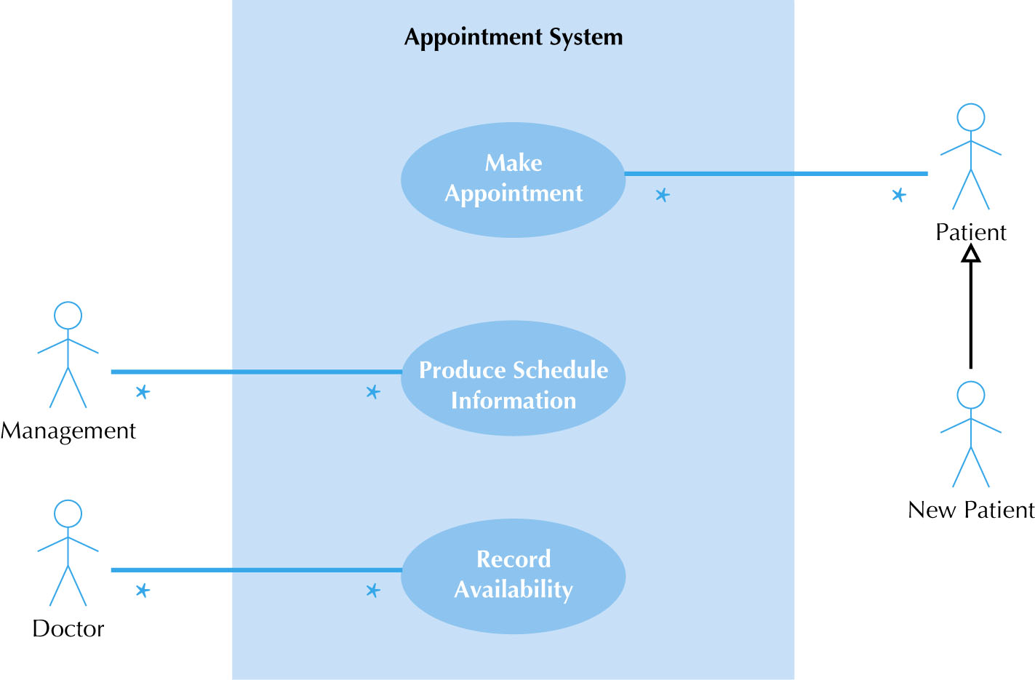
Use Case Diagram with Specialized Actor

Slide 78
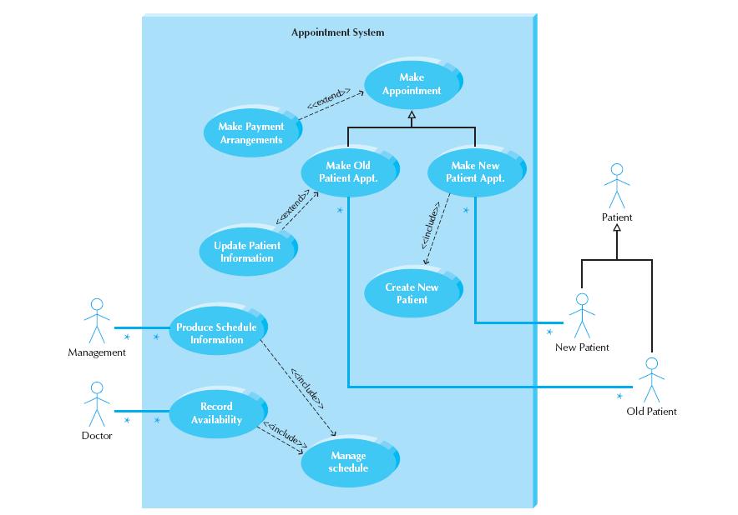
Extend and Include Relationships

Slide 79
Sistem Konsultasi Dokter Rumah Sakit

Slide 80
Studi Kasus: ATM System

Slide 81
Use Case Diagram (versi Sederhana)

Slide 82
Use Case Diagram (versi include dan extends)

Slide 83
ERP Perbankan (Sistem Lebih Kompleks)

Slide 84
Use Case Diagram (Versi Normal)

Slide 85
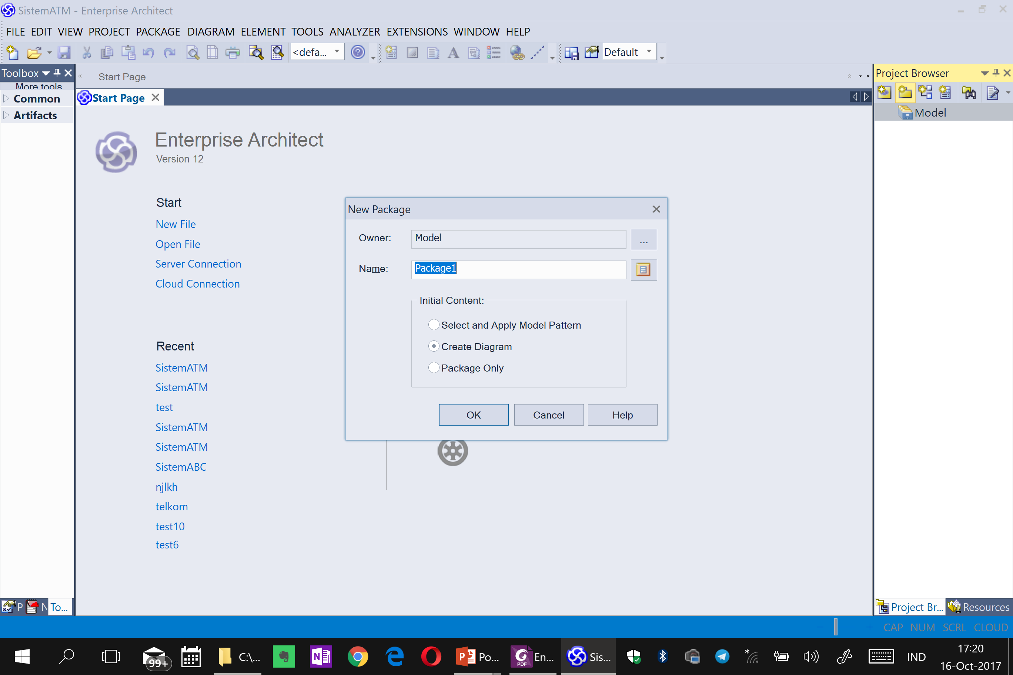

Slide 86
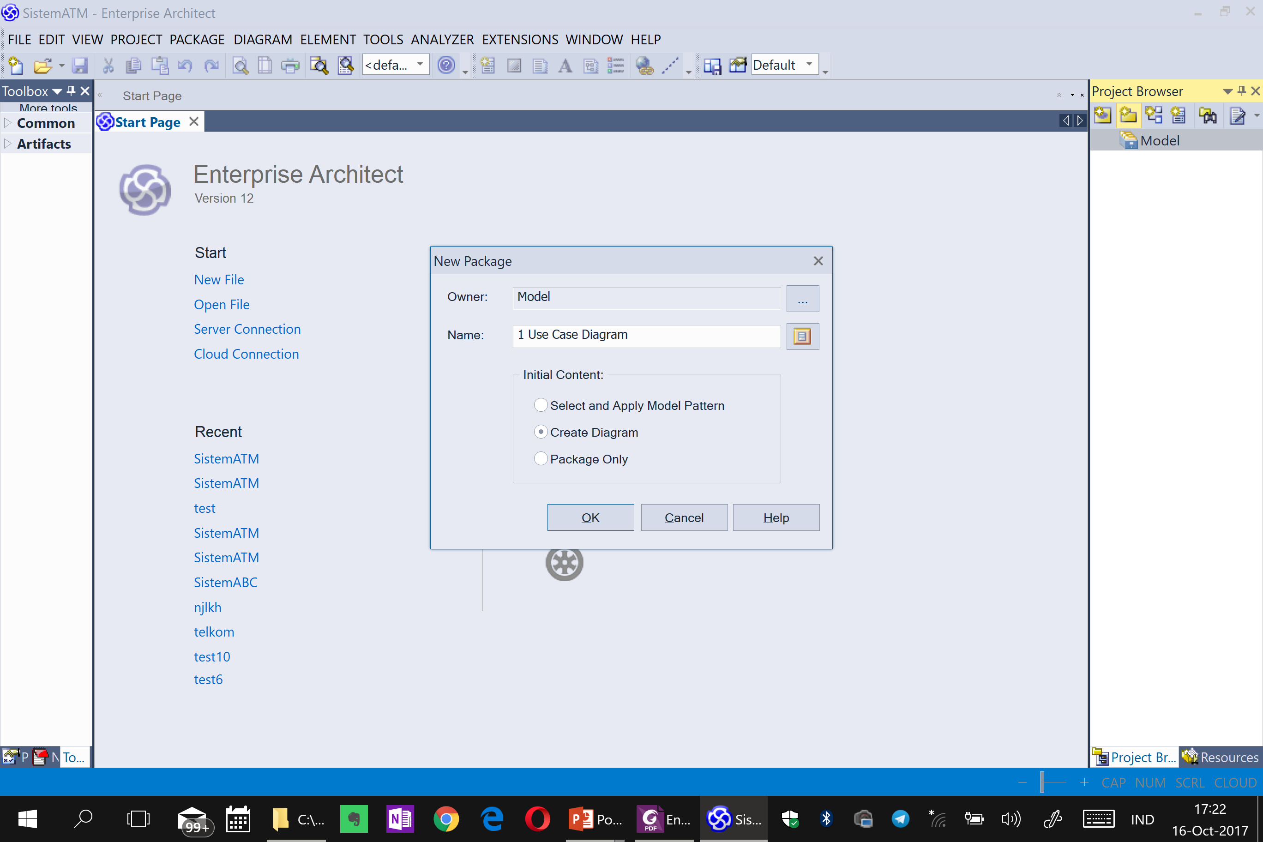

Slide 87
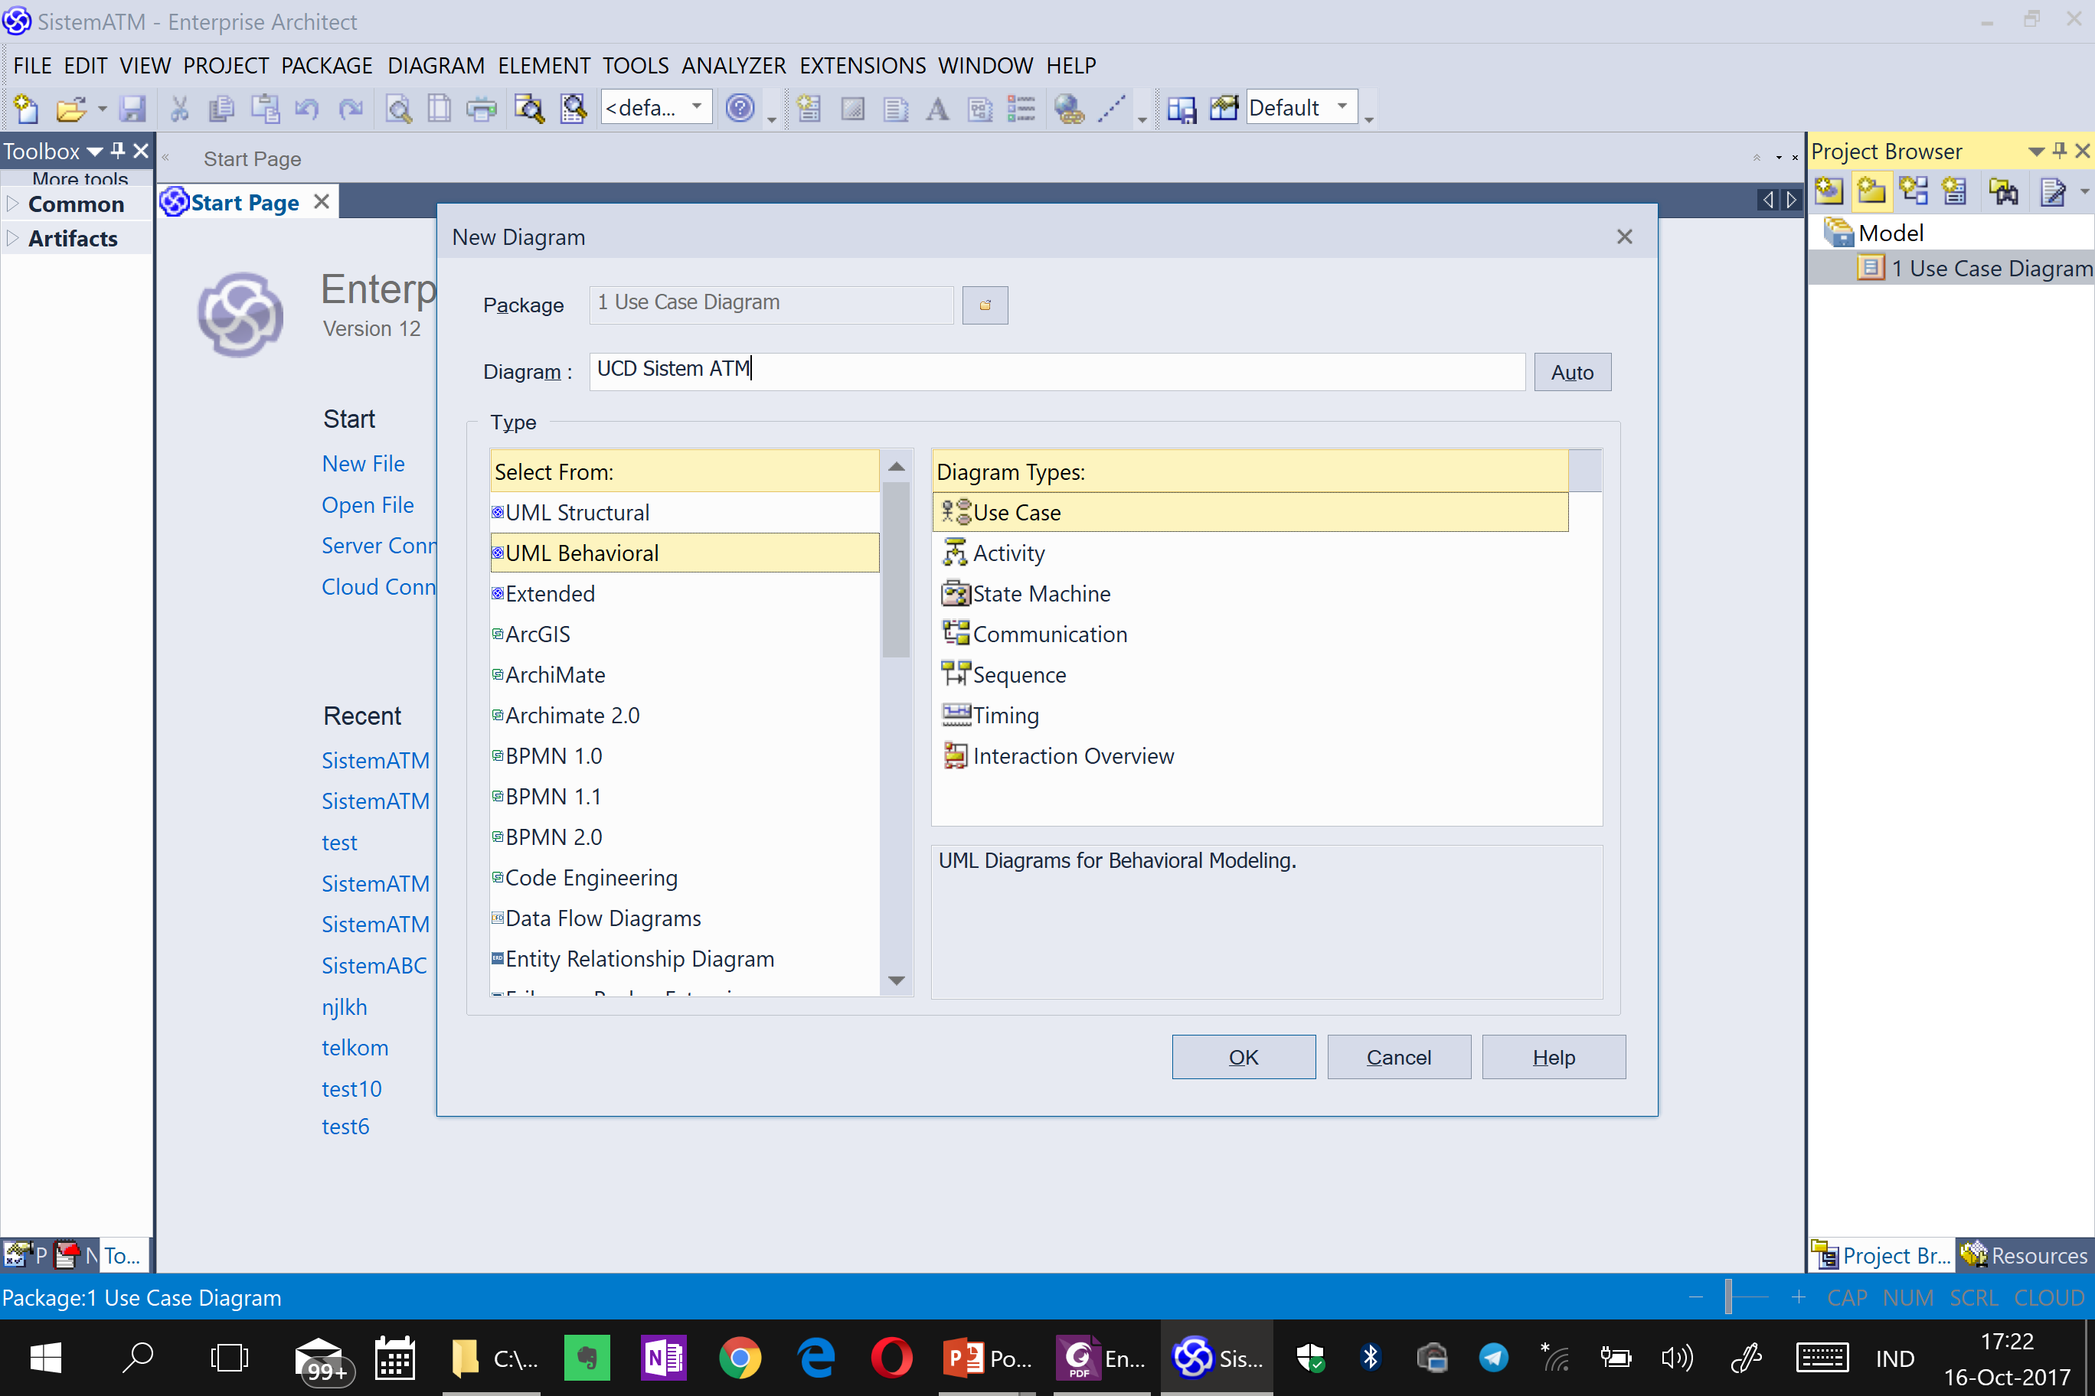

Slide 88
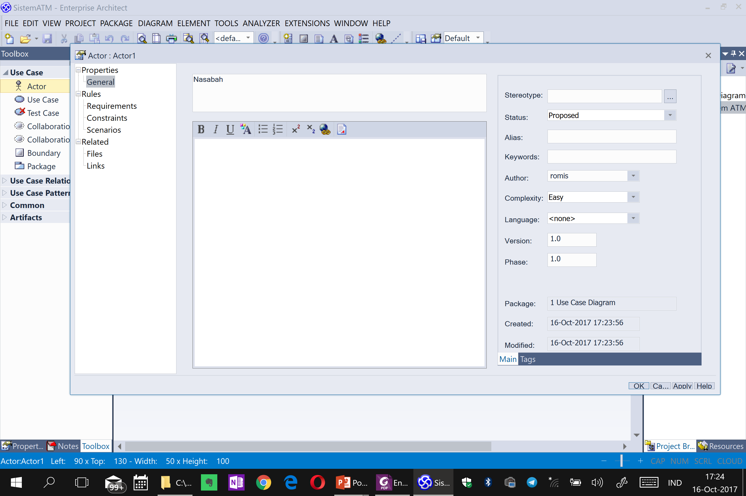

Slide 89
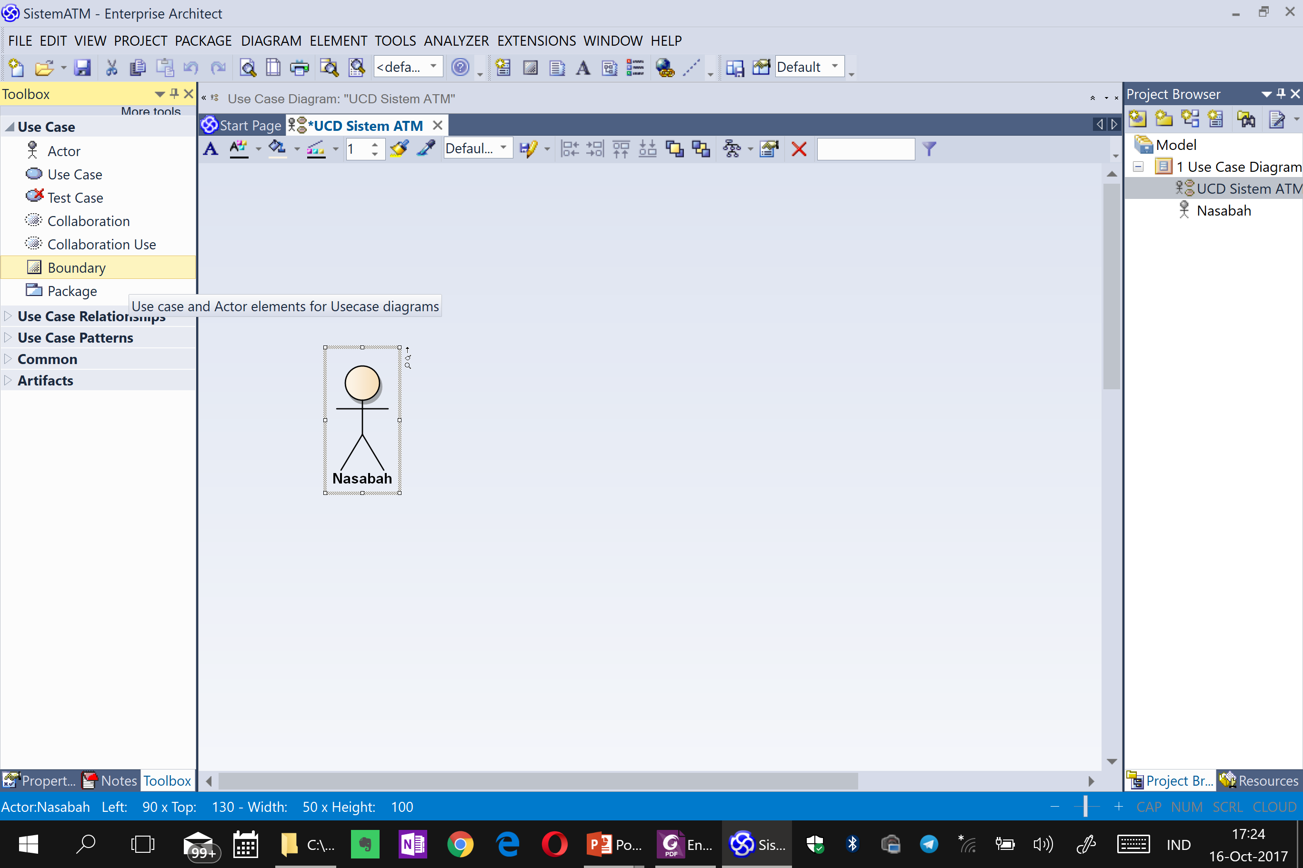

Slide 90
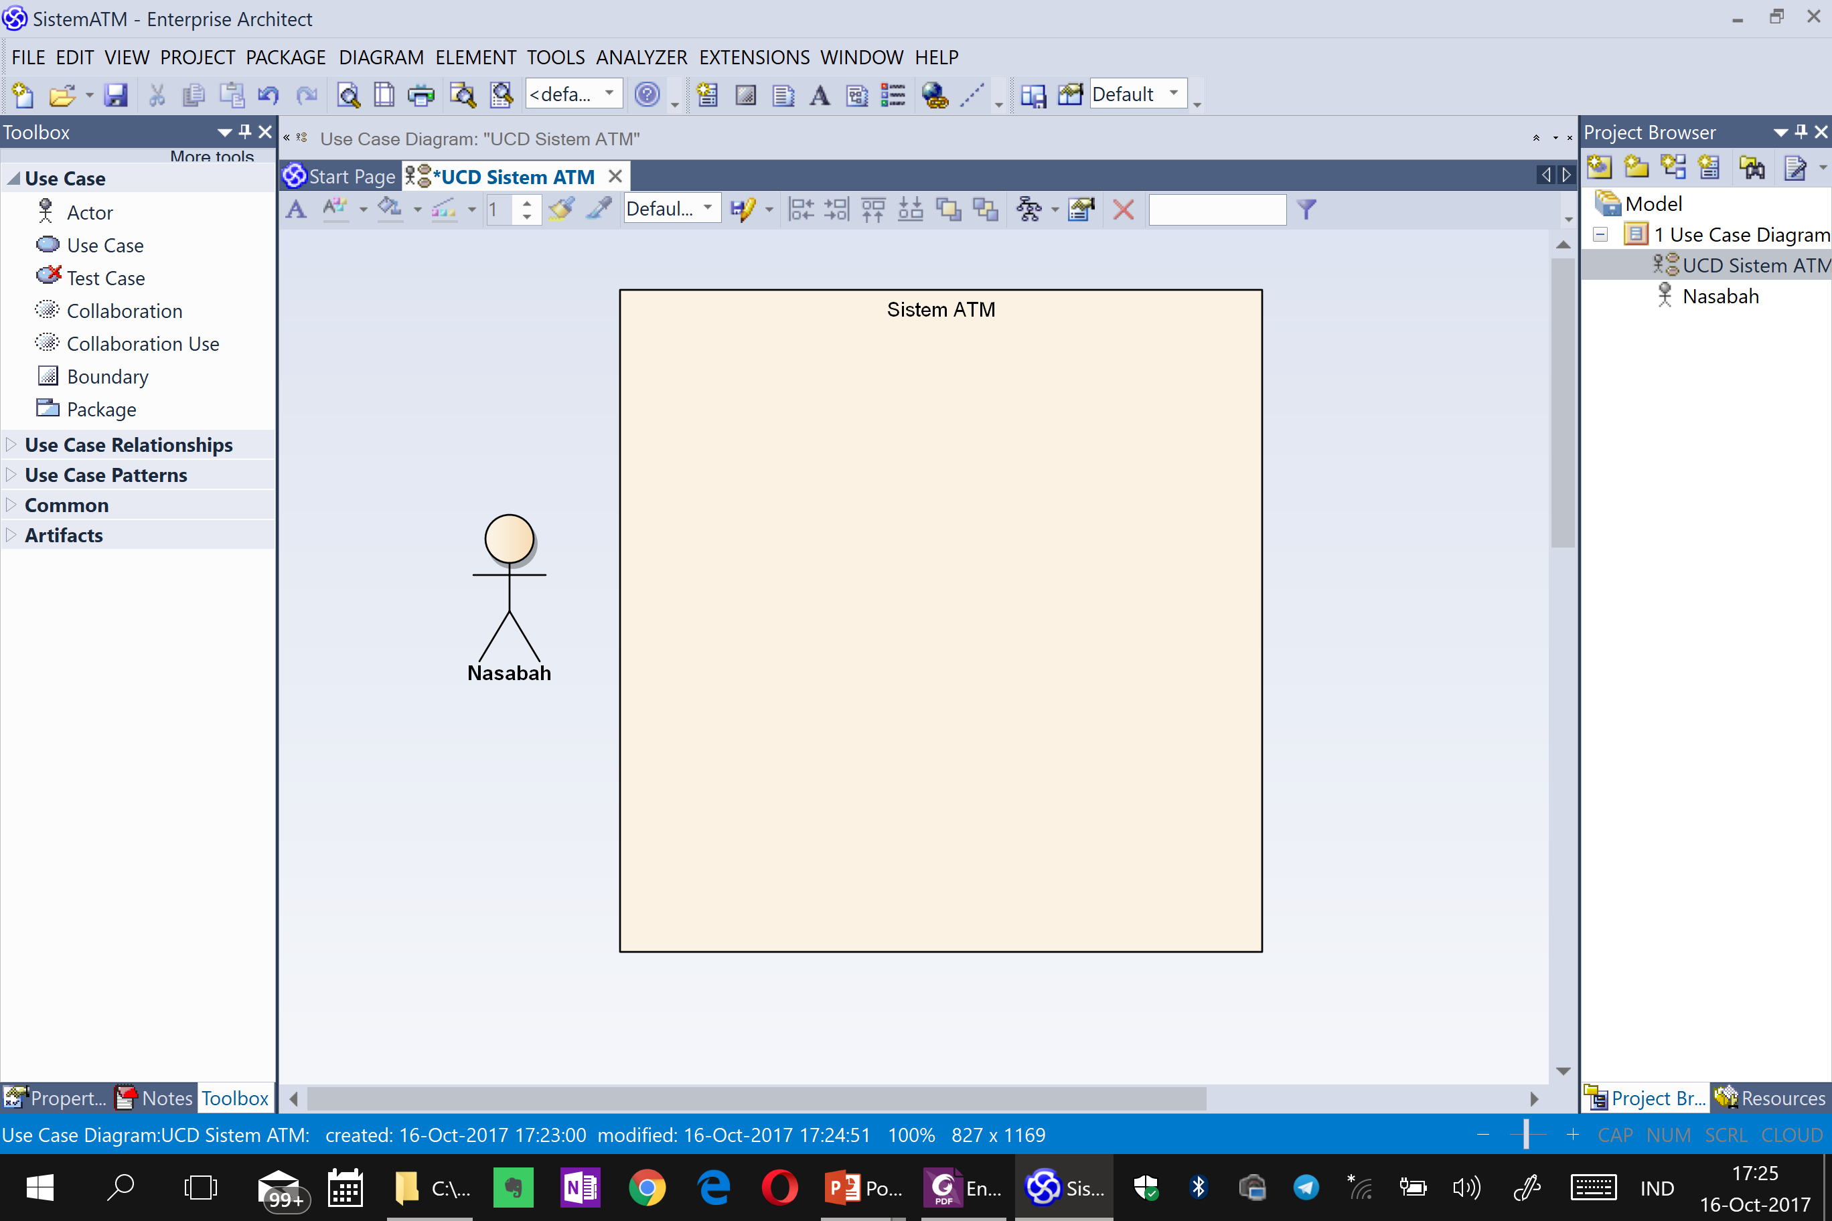

Slide 91
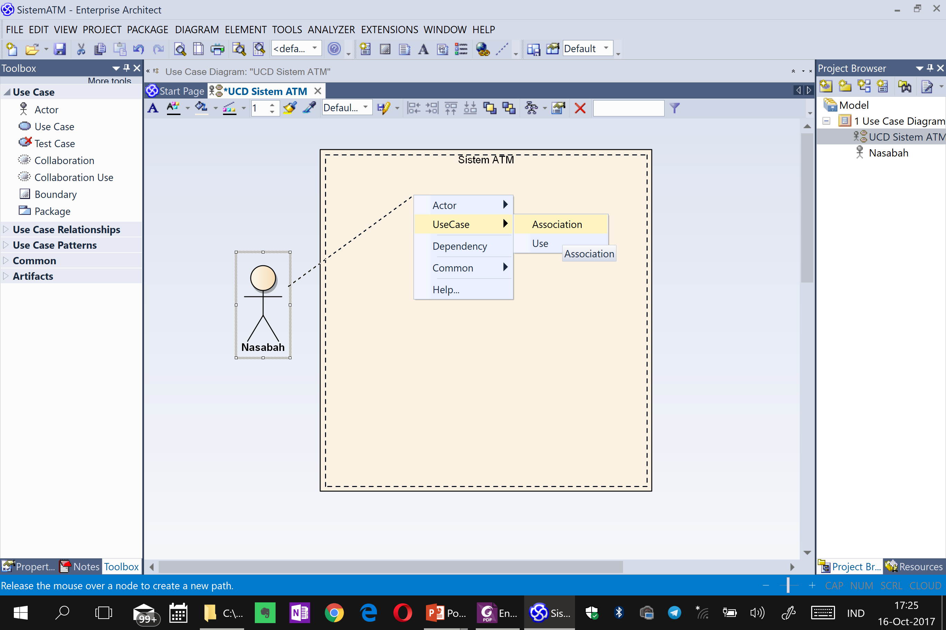

Slide 92
Exercise: Business Process Identification
Buat project baru di Sparx EA, dengan nama file adalah nama project sesuai System Request
Lihat kembali dan rapikan System Request yang sudah anda buat
Lakukan business process identification dengan membuatkan Use Case Diagram untuk System Request tersebut
Kirim System Request, Feasibillity Analysis (PPT dan XLS) dan Use Case Diagram (EAP) via Telegram 081586220090 atau email ke romi@brainmatics.com

Slide 93
Exercise: Systems Analysis and Design
Lakukan sistem analysis and design yang menghasilkan diagram:
Use Case Diagram
Pilih salah satu aplikasi di bawah:
Aplikasi Rental Mobil
Aplikasi Pengelolaan Klinik
Aplikasi Pengelolaan Apotik
Aplikasi Pengelolaan Service Mobil
Aplikasi Penjualan Motor
Aplikasi Pengelolaan Perpustakaan
Aplikasi Penjualan Buku Online
Aplikasi Penjualan Tiket Kereta Online
Aplikasi Manajemen Universitas Online
Aplikasi Penjualan Laptop Online
Aplikasi Perpustakaan Digital
Aplikasi Pengelolaan Project Software

Slide 94
3.3.4 Business Process Modeling
Activity Diagram
Business Process Model and Notation

Slide 95
System Analysis and Design with UML
System Analysis
Business Process Identification
Use Case Diagram
Business Process Modeling
Activity Diagram or Business Process Modeling Notation (BPMN)
Business Process Realization
Sequence Diagram (Buat untuk setiap use case dengan menggunakan pola Boundary-Control-Entity)
System Design
Program Design
Class Diagram (Gabungkan Boundary-Control-Entity Class dan susun story dari sistem yang dibangun)
Package Diagram (Gabungan class yang sesuai, boleh menggunakan pola B-C-E)
Deployment Diagram (arsitektur software dari sistem yang dibangun)
User Interface Design (Buat UI design dari Boundary Class)
Entity-Relationship Model (Buat ER diagram dari Entity Class)

Slide 96
Business Process Modeling with Activity Diagrams

Slide 97
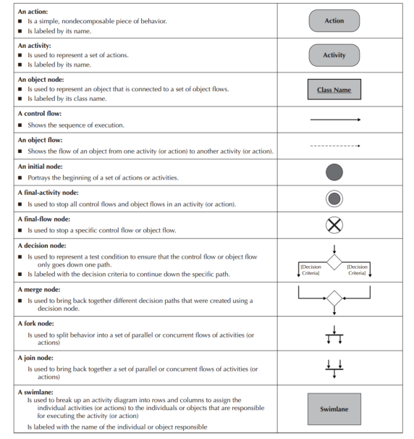
Activity Diagram Syntax

Slide 98
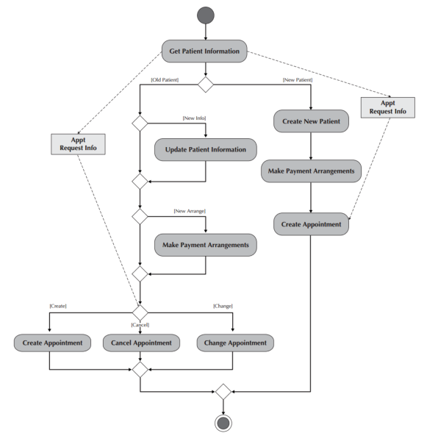
Activity Diagram Example

Slide 99
Creating Activity Diagrams
Set the context or scope of the activity being modeled
Identify the activities and control/object flows between activities
Identify any decisions made
Look for opportunities for parallelism
Draw the diagram

Slide 100
Business Process Modeling with BPMN

Slide 101
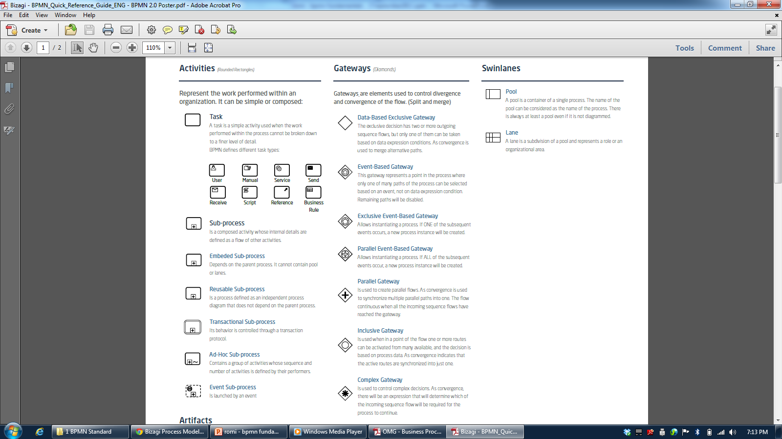
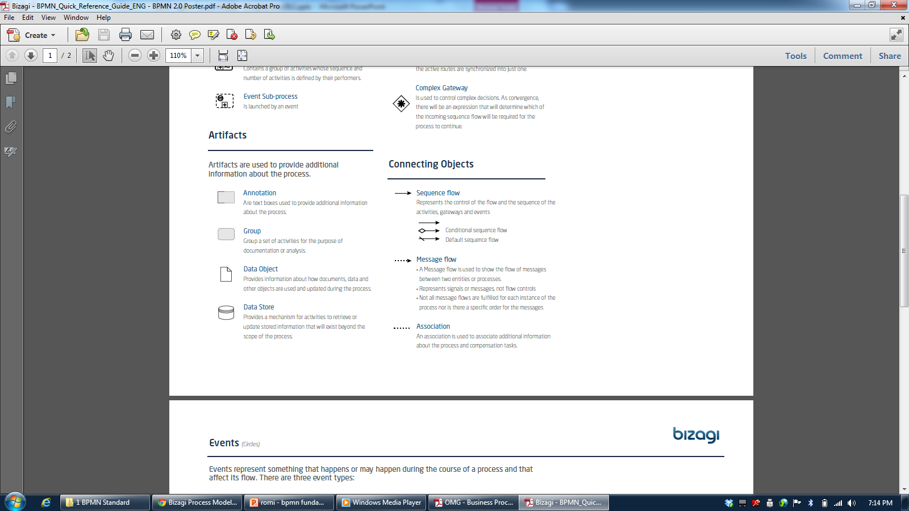

Slide 102
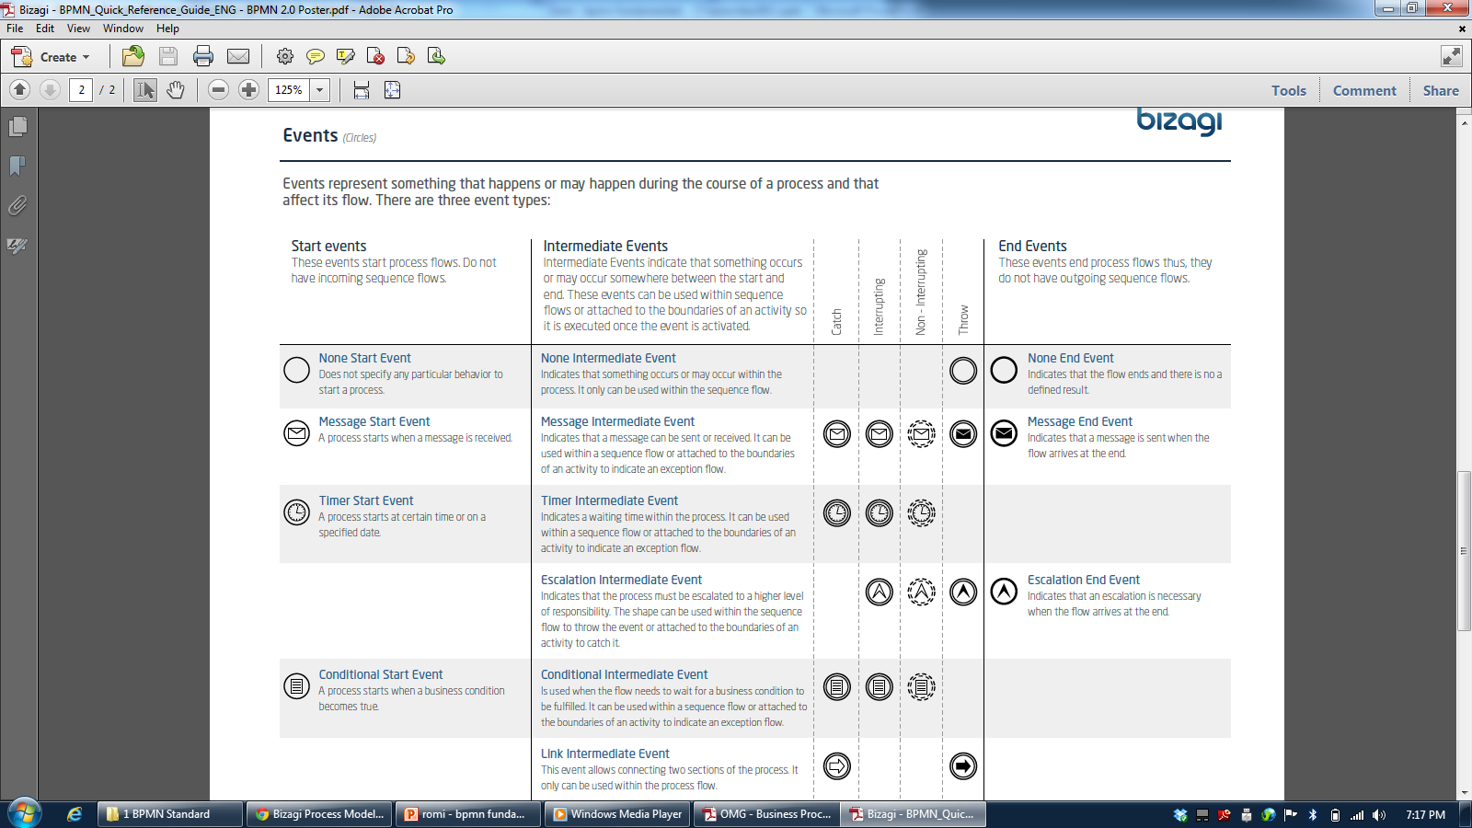

Slide 103
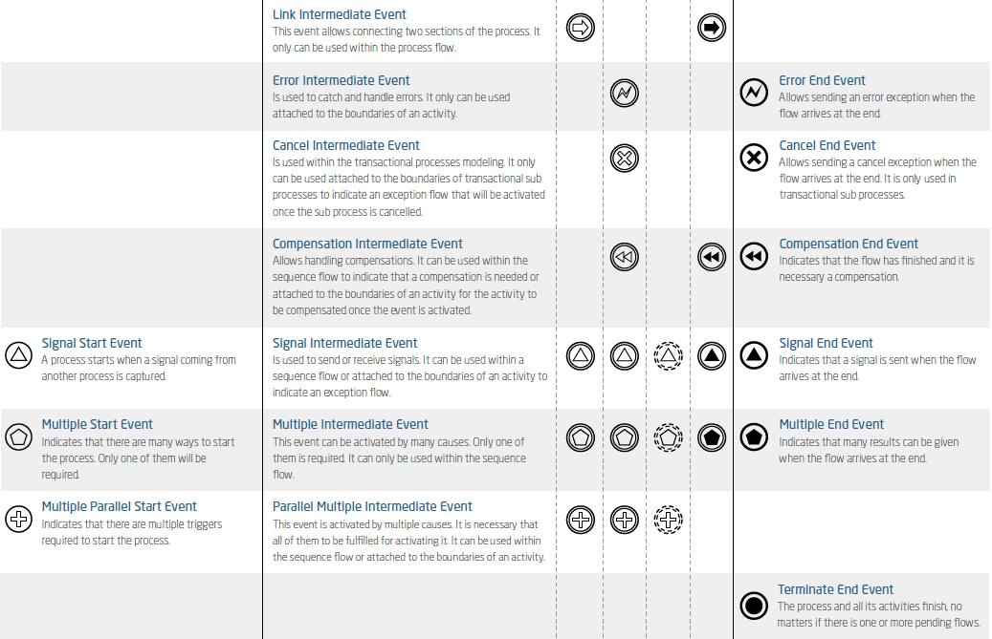

Slide 104
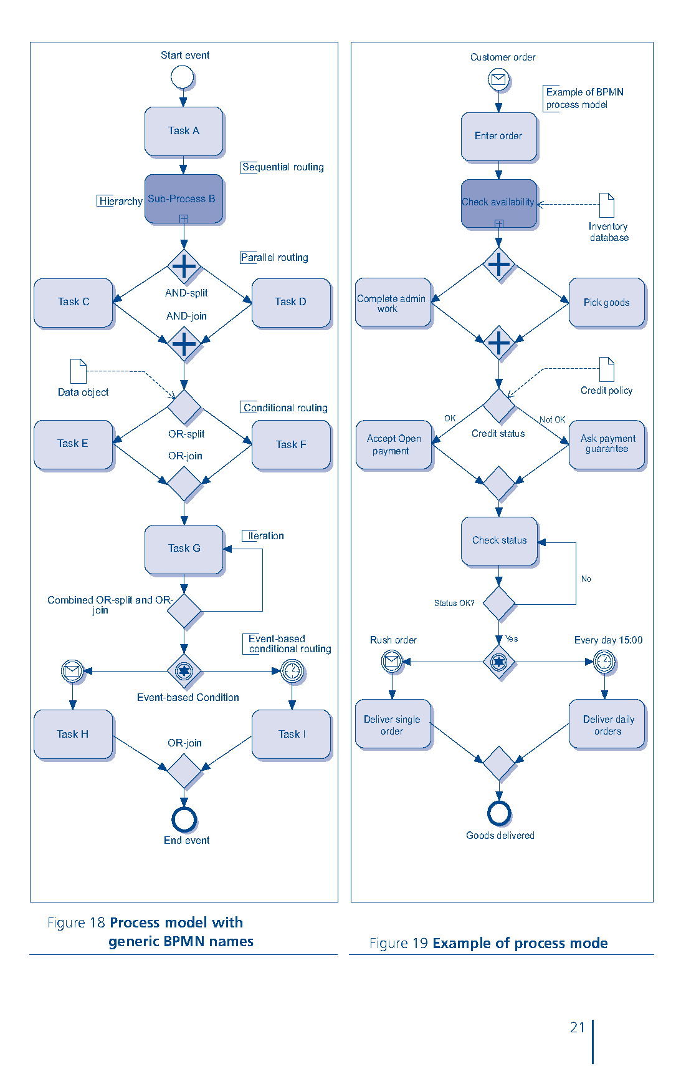

Slide 105
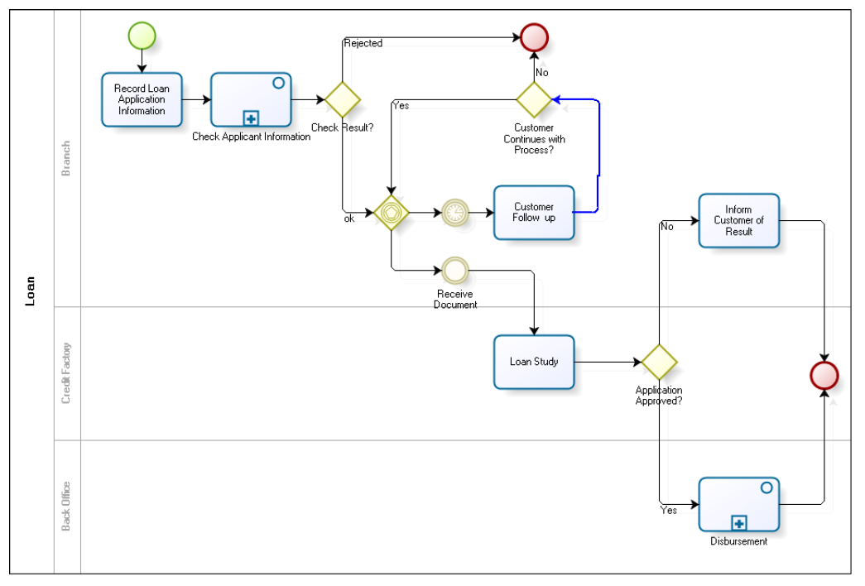
Credit Application

Slide 106
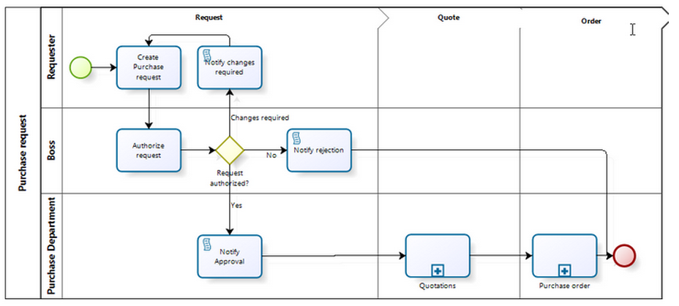
Purchase Request

Slide 107
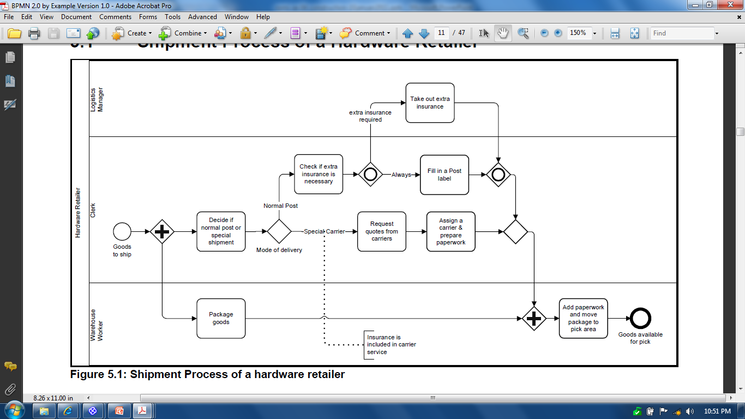
Shipment Process of a Hardware Retailer

Slide 108
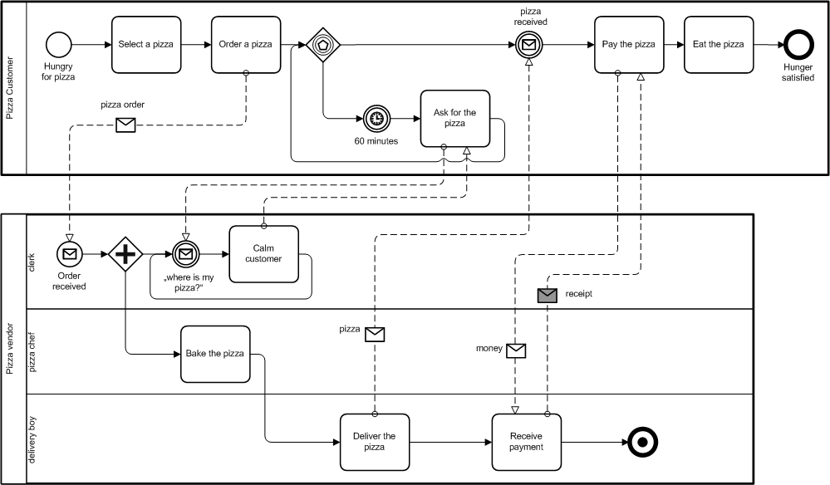
The Pizza Collaboration

Slide 109
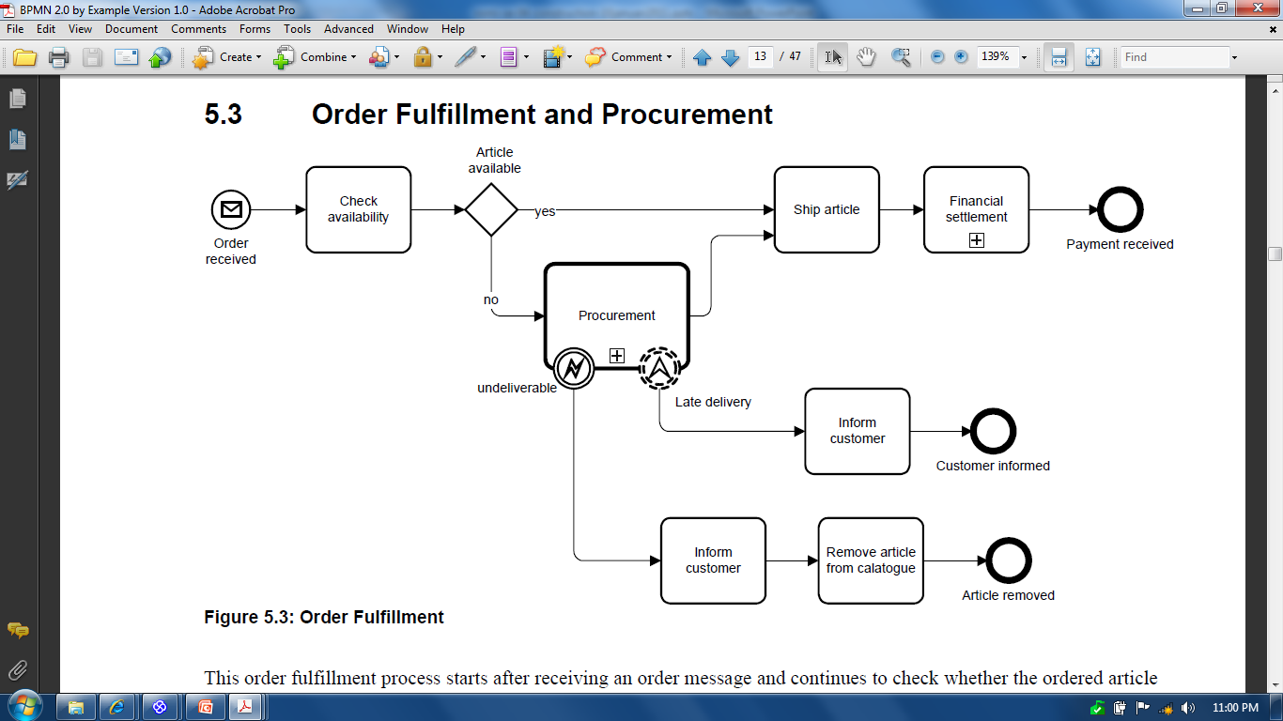
Order Fulfillment and Procurement

Slide 110
Studi Kasus: ATM System

Slide 111
Use Case Diagram

Slide 112
Activity Diagram: Memasukkan Kartu

Slide 113
Activity Diagram: Memasukkan PIN

Slide 114
Activity Diagram: Mengecek Saldo

Slide 115
Activity Diagram: Mengambil Uang

Slide 116
Activity Diagram: Mengirim Uang

Slide 117
Activity Diagram: Mengupdate Informasi Kotak Deposit

Slide 118
Activity Diagram: Keluar Sistem

Slide 119
Exercise: Business Process Modeling
Lihat kembali System Request dan Use Case Diagram yang sudah anda buat
Lakukan business process modeling dengan membuatkan Activity Diagram untuk setiap Use Case yang dibuat
Kirimkan file di bawah ke romi@brainmatics.com
System Request, Feasibility Analysis, Project Size Estimation (FP) (PPT dan XLS)
Use Case Diagram, Activity Diagram (EAP)

Slide 120
Exercise: Systems Analysis and Design
Lakukan sistem analysis and design yang menghasilkan diagram:
Use Case Diagram
Activity Diagram
Pilih salah satu aplikasi di bawah:
Aplikasi Rental Mobil
Aplikasi Pengelolaan Klinik
Aplikasi Pengelolaan Apotik
Aplikasi Pengelolaan Service Mobil
Aplikasi Penjualan Motor
Aplikasi Pengelolaan Perpustakaan
Aplikasi Penjualan Buku Online
Aplikasi Penjualan Tiket Kereta Online
Aplikasi Manajemen Universitas Online
Aplikasi Penjualan Laptop Online
Aplikasi Perpustakaan Digital
Aplikasi Pengelolaan Project Software
Aplikasi Pemesanan Taxi

Slide 121
3.3.5 Business Process Realization
Sequence Diagram

Slide 122
System Analysis and Design with UML
System Analysis
Business Process Identification
Use Case Diagram
Business Process Modeling
Activity Diagram or Business Process Modeling Notation (BPMN)
Business Process Realization
Sequence Diagram (Buat untuk setiap use case dengan menggunakan pola Boundary-Control-Entity)
System Design
Program Design
Class Diagram (Gabungkan Boundary-Control-Entity Class dan susun story dari sistem yang dibangun)
Package Diagram (Gabungan class yang sesuai, boleh menggunakan pola B-C-E)
Deployment Diagram (arsitektur software dari sistem yang dibangun)
User Interface Design (Buat UI design dari Boundary Class)
Entity-Relationship Model (Buat ER diagram dari Entity Class)

Slide 123
Sequence Diagram Syntax
AN ACTOR
AN OBJECT
A LIFELINE
A FOCUS OF CONTROL
A MESSAGE
OBJECT DESTRUCTION
anObject:aClass
aMessage()
x

Slide 124
Sequence Diagram
Susun Sequence Diagram untuk setiap Use Case yang dibuat
Mulai dari menarik Actor yang ada di Use Case Diagram, lanjutkan dengan membuat sequence detail dari berjalannya Use Case
Catatan: Objek dari Lifeline di Sequence Diagram akan menjadi kandidat Class

Slide 125
Jenis Class
Boundary Class:
Class yang berinteraksi dengan aktor langsung (user interface)
Form, input, UI ini masuk di sini
Control Class:
Class yang berhubungan dengan pemrosesan, penghitungan, kalkulasi, komputasi, query, dst
Entity Class:
Class yang berhubungan dengan data, penyimpanan data/file

Slide 126
Studi Kasus: ATM System

Slide 127
Sequence Diagram: Memasukkan Kartu

Slide 128
Sequence Diagram: Memasukkan PIN

Slide 129
Sequence Diagram: Mengecek Saldo

Slide 130
Sequence Diagram: Mengambil Uang

Slide 131
Sequence Diagram: Mengirim Uang

Slide 132
Sequence Diagram: Mengupdate Informasi Kotak Deposit

Slide 133
Sequence Diagram: Keluar Sistem

Slide 134
Exercise: System Analysis untuk System Request
Lihat kembali System Request yang sudah anda buat
Lakukan system analysis dengan membuat diagram di bawah:
Use Case Diagram
Activity Diagram
Sequence Diagram
Lakukan estimasi size dari project dengan menggunakan Use Case Point
Kirim file EAP ke romi@brainmatics.com

Slide 135
Exercise: Systems Analysis and Design
Lakukan sistem analysis and design yang menghasilkan diagram:
Use Case Diagram
Activity Diagram
Sequence Diagram
Penghitungan Size dengan Use Case Point
Pilih salah satu aplikasi di bawah:
Aplikasi Rental Mobil
Aplikasi Pengelolaan Klinik
Aplikasi Pengelolaan Apotik
Aplikasi Pengelolaan Service Mobil
Aplikasi Penjualan Motor
Aplikasi Pengelolaan Perpustakaan
Aplikasi Penjualan Buku Online
Aplikasi Penjualan Tiket Kereta Online
Aplikasi Manajemen Universitas Online
Aplikasi Penjualan Laptop Online
Aplikasi Perpustakaan Digital
Aplikasi Pengelolaan Project Software

Slide 136
Rangkuman Studi Kasus Sistem ATM

Slide 137
SDLC and Deliverables
Planning
1.1 System Request
1.2 Feasibility Analysis
Analysis
2.1 Use Case Diagram
2.2 Activity Diagram
2.3 Sequence Diagram
Design
3.1 Class Diagram
3.2 Deployment Diagram
3.3 User Interface Design
3.4 Data Model
Implementation 4.1 Program Code 4.2 Testing Plan 4.3 Documentation
System
Proposal
System
Specification
New
Software

Slide 138
Planning (System Proposal)
System Request (Business Value Identification)
Lower Cost
Increase Profit
Feasibility Analysis
Technical (Capabilities)
Economic (ROI, BEP)
Organizational (Goals, Core Business)

Slide 139
System Request: CD Selection Project
Project Sponsor: | Margaret Mooney, Vice President of Marketing
Business Needs: | Project ini dibangun untuk: Mendapatkan pelanggan baru lewat Internet Memberikan layanan pendukung dengan menggunakan internet
Business Requirements:
CD Selection project adalah sistem yang mendukung penjualan CD lewat internet. Fitur-fitur yang harus ada di sistem ini adalah sebagai berikut: Fitur Pencarian Produk Fitur Pencarian Toko yang Menyediakan Stok Produk Fitur Pemesanan Produk Melalui Toko yang Menyediakan Fitur Pembayaran dengan Berbagai Pilihan Pembayaran
Business Value:
Intangible Value: Meningkatkan kepuasan pelanggan Meningkatkan brand recognition tentang perusahaan di dunia Internet Tangible Value: 1. Meningkatkan penjualan dari pelanggan baru lewat Internet: Rp.400.000.000,- peningkatan penjualan dari pelanggan baru dan Rp.600.000.000,- dari pelanggan lama 2. Mengurangi biaya operasional untuk menangani komplain dari pelanggan Rp.100.000.000,- pengurangan tahunan biaya telepon untuk menangani pelanggan

Slide 140
Studi Kelayakan Sistem Penjualan CD
Margaret Mooney dan Alec Adams membuat studi kelayakan untuk pengembangan Sistem Penjualan CD
Kelayakan Teknis Sistem Penjualan CD layak secara teknis, meskipun memiliki beberapa risiko. Risiko Berhubungan dengan Kefamilieran dengan Aplikasi: Resiko Tinggi Divisi Marketing tidak memiliki pengalaman menggunakan sistem penjualan online Divisi IT memiliki pemahaman yang baik tentang sistem penjualan CD, akan tetapi tidak berpengalaman mengembangkan sistem penjualan CD berbasis web (online) Risiko Berhubungan dengan Kefamilieran dengan Teknologi: Resiko Sedang Divisi IT tidak menguasai masalah infrastruktur dan ISP, tetapi akan menyewa konsultan Divisi IT cukup familier dengan framework dan IDE yang akan digunakan Divisi Marketing tidak memiliki pengalaman menggunakan teknologi Web Risiko berhubungan dengan Ukuran Project: Risiko Rendah Perusahaan memiliki total 30 orang pengembang Project dikerjakan oleh 5 orang pengembang dengan estimasi waktu 6 bulan Kompatibilitas dengan sistem dan infrastruktur yang ada: Risiko Rendah Sistem pemesanan yang ada sekarang menggunakan open standard, jadi sangat kompatibel dengan sistem penjualan berbasis web yang akan dibangun

Slide 141
Kelayakan Ekonomi
Cost benefit analysis telah dilakukan. Sistem Penjualan CD memiliki peluang yang baik untuk bisa meningkatkan pendapatan perusahaan. Return on Investment (ROI) setelah 3 tahun: 26.2% Break-even point (BEP): 2.28 tahun Total keuntungan setelah 3 tahun: Rp.429.878.356,- Keuntungan Intangible Meningkatkan kepuasaan pelanggan Meningkatkan branding perusahaan
Kelayakan Organisasi
Secara organisasi, resikonya rendah. Tujuan dari pengembangan sistem penjualan CD adalah meningkatkan penjualan perusahaan. Dan ini selaras dengan KPI divisi marketing yang ke arah peningkatan kuantitas penjualan Project champion dari pengembangan Sistem Penjualan CD ini adalah Margaret Mooney, Vice President of Marketing

Slide 142
 | 2016 | 2017 | 2018
Peningkatan penjualan dari pelanggan baru | 0 | 400,000,000 | 500,000,000
Peningkatan penjualan dari pelanggan lama | 0 | 600,000,000 | 700,000,000
Pengurangan biaya operasional dan telepon | 0 | 100,000,000 | 100,000,000
Total Benefits: | 0 | 1,100,000,000 | 1,300,000,000
PV of Benefits: | 0 | 978,996,084 | 1,091,505,068
PV of All Benefits: | 0 | 978,996,084 | 2,070,501,152
Honor Tim (Analysis, Design and Implementation) | 360,000,000 | 0 | 0
Honor Konsultan | 90,000,000 | 0 | 0
Total Development Costs: | 450,000,000 | 0 | 0
Honor Pengelola Web | 60,000,000 | 70,000,000 | 80,000,000
Biaya Lisensi Software | 50,000,000 | 60,000,000 | 70,000,000
Hardware upgrades | 100,000,000 | 100,000,000 | 100,000,000
Biaya Komunikasi | 20,000,000 | 30,000,000 | 40,000,000
Biaya Marketing | 100,000,000 | 200,000,000 | 300,000,000
Total Operational Costs: | 330,000,000 | 460,000,000 | 590,000,000
Total Costs: | 780,000,000 | 460,000,000 | 590,000,000
PV of Costs: | 735,849,057 | 409,398,362 | 495,375,377
PV of all Costs: | 735,849,057 | 1,145,247,419 | 1,640,622,796
Total Project Costs Less Benefits: | -780,000,000 | 640,000,000 | 710,000,000
Yearly NPV: | -735,849,057 | 569,597,722 | 596,129,691
Cumulative NPV: | -735,849,057 | -166,251,335 | 429,878,356
Return on Investment (ROI) di Tahun 3: 26.2% | 429,878,356/1,640,622,796 |  | 0.262021445
Break-even Point (BEP): 2.28 tahun | 2 + (596,129,691-429,878,356)/ 596,129,691 |  | 2.278884507
System Request (Business Value)

Slide 143
System Analysis and Design with UML
System Analysis
Business Process Identification
Use Case Diagram
Business Process Modeling
Activity Diagram or Business Process Modeling Notation (BPMN)
Business Process Realization
Sequence Diagram (Buat untuk setiap use case dengan menggunakan pola Boundary-Control-Entity)
System Design
Program Design
Class Diagram (Gabungkan Boundary-Control-Entity Class dan susun story dari sistem yang dibangun)
Package Diagram (Gabungan class yang sesuai, boleh menggunakan pola B-C-E)
Deployment Diagram (arsitektur software dari sistem yang dibangun)
User Interface Design (Buat UI design dari Boundary Class)
Entity-Relationship Model (Buat ER diagram dari Entity Class)

Slide 144
Use Case Diagram

Slide 145
Activity Diagram: Memasukkan Kartu

Slide 146
Activity Diagram: Memasukkan PIN

Slide 147
Activity Diagram: Mengecek Saldo

Slide 148
Activity Diagram: Mengambil Uang

Slide 149
Activity Diagram: Mengirim Uang

Slide 150
Activity Diagram: Mengupdate Informasi Kotak Deposit

Slide 151
Activity Diagram: Keluar Sistem

Slide 152
Sequence Diagram: Memasukkan Kartu

Slide 153
Type of Class
Boundary Class
Class yang berhubungan dengan actor (user interface)
Control Class
Class yang berhubungan dengan pemrosesan, komputasi, penghitungan, dsb
Entity Class
Class yang berhubungan dengan data (flat file or database)

Slide 154
Sequence Diagram: Memasukkan PIN

Slide 155
Sequence Diagram: Mengecek Saldo

Slide 156
Sequence Diagram: Mengambil Uang

Slide 157
Sequence Diagram: Mengirim Uang

Slide 158
Sequence Diagram: Mengupdate Informasi Kotak Deposit

Slide 159
Sequence Diagram: Keluar Sistem

Slide 160
Class Diagram

Slide 161
Deployment Diagram (3 Tier)

Slide 162
Data Model

Slide 163
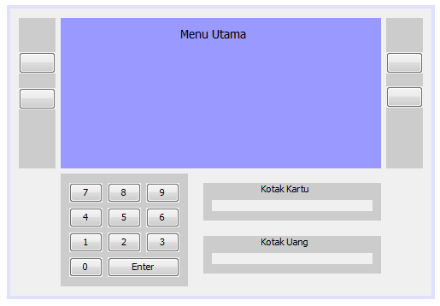
User Interface Design

Slide 164
User Interface Design (Sparx EA)

Slide 165
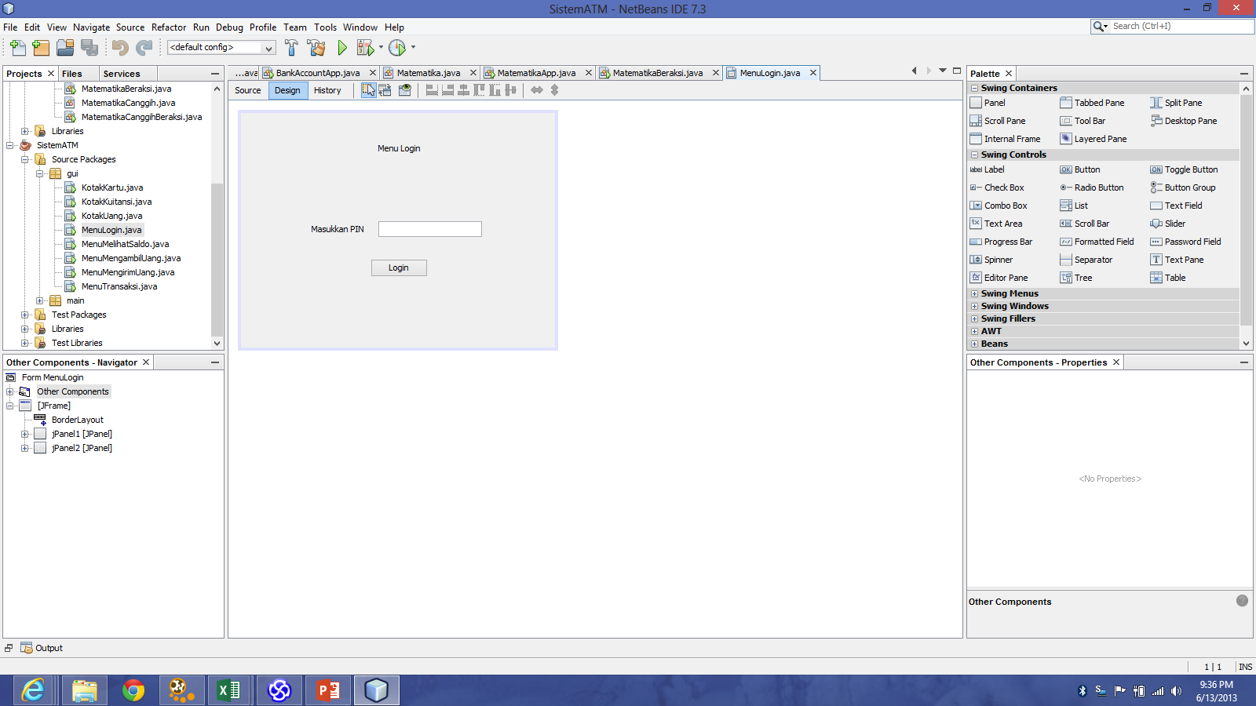
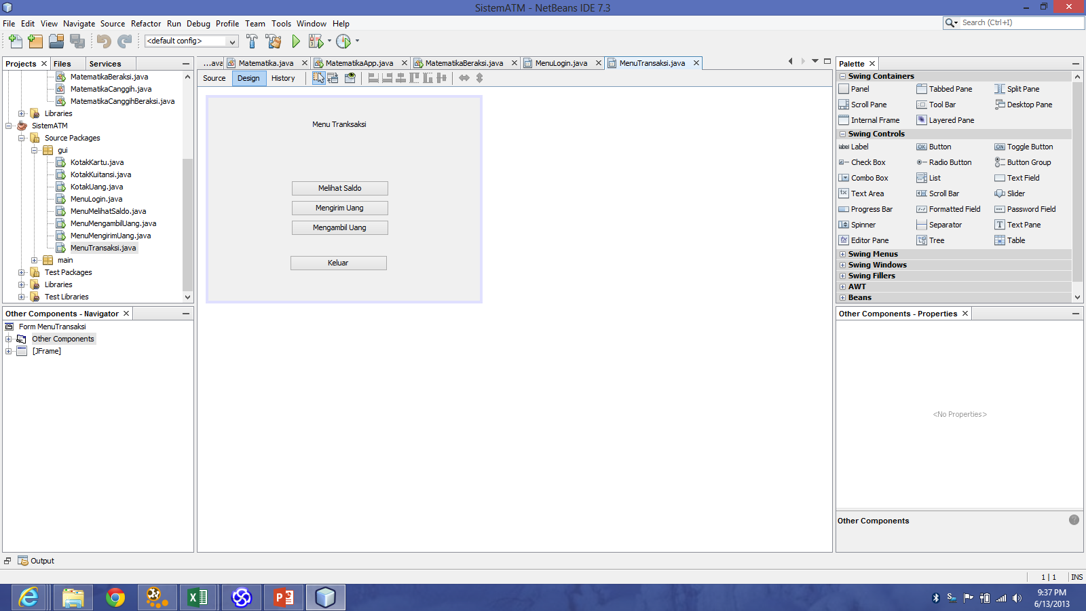
User Interface Design (Netbeans)

Slide 166
Catatan Review
Gunakan pola Subject-Verb-Object (S-V-O) untuk use case diagram (Actor – Use Case) dan Activity Diagram (Partition – Action)
Use Case Diagram adalah apa yang dilakukan Actor di sistem, bukan apa yang dilakukan oleh sistem
Pada Sequence Diagram perhatikan transaksi yang harusnya datangnya dari actor, dan bukan dari object lain
Naming untuk object dan class adalah kata benda (noun), untuk message di Sequence Diagram (method) adalah kata kerja
Object lifeline dan message di Sequence Diagram dan nama class di Class Diagram, tidak boleh menggunakan spasi, karena akan jadi Class dan Method di kode program
Actor akan mengirim message hanya ke Boundary Class, tidak ke Control atau Entity Class
Entity Class bukan consumer, jadi tidak pernah mengirim message ke Boundary atau Control Class
Boundary class akan menjadi UI Design, entity class akan menjadi Data Model
Class diagram tidak menunjukkan alur, tapi menunjukkan struktur dan komposisi dari sistem yg kita bangun

Slide 167
References
Alan Dennis et al, Systems Analysis and Design with UML 4th Edition, John Wiley and Sons, 2013
Kenneth E. Kendall and Julie E Kendall, Systems Analysis and Design 8th Edition, Prentice Hall, 2010
John W. Satzinge, Robert B. Jackson, Stephen D. Burd, Systems Analysis and Design in a Changing World 6th Edition, Course Technology, 2012
Hassan Gomaa, Software Modeling and Design: UML, Use Cases, Patterns, and Software Architectures, Cambridge University Press, 2011
Gary B. Shelly and Harry J. Rosenblatt, Systems Analysis and Design 9th Edition, Course Technology, 2011
Howard Podeswa, UML for the IT Business Analyst 2nd Edition, Course Technology, 2009
Jeffrey A. Hoffer et al, Modern Systems Analysis and Design 6th Edition, Prentice Hall, 2010

